Slide 1





Supervised & Unsupervised Encoding Schemes of Binary Variables for Prediction Performance Enhancement
Institute of Industrial Engineering, NTU
Yun-Hao Yang, Jakey Blue
Notes:
各位口試委員、教授、同學們好，我是台大工業工程研究所的研究生 楊雲皓
很開心也很榮幸能與在座的分享我與藍俊宏老師的研究題目－針對二元特徵資料的編碼框架，提升模型預測表現

Slide 2

Overview
Motivation
Methodology
Case study
Conclusion & Future work
Notes:
在接下來的半小時中，會先簡述本研究的發想與動機
接著描述研究所發展的方法
於案例分析中，由不同的資料集驗證本方法的可行性
最後歸納總結研究結果，和未來整體實驗規劃方向

Slide 3
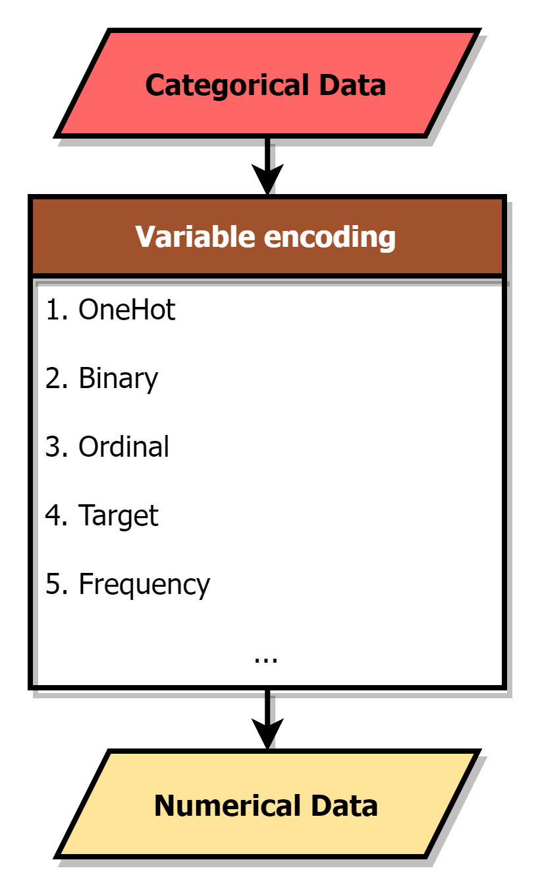
Motivation
Shape
■
▲
●
Variable Encoding
Categorical |  | Numerical
City |  | Ordinal | Binary |  | OneHot |  |  |  | Frequency
Taipei
 |  | 0 | 0 | 0 | 0 | 0 | 0 | 1 | 0.2
New York
 |  | 1 | 0 | 1 | 0 | 0 | 1 | 0 | 0.2
London
 |  | 2 | 1 | 0 | 0 | 1 | 0 | 0 | 0.2
Tokyo
 |  | 3 | 1 | 1 | 1 | 0 | 0 | 0 | 0.2
Tokyo
 |  | 3 | 1 | 1 | 1 | 0 | 0 | 0 | 0.4
ENCODER
■ | ▲ | ●
0 | 0 | 1
0 | 1 | 0
1 | 0 | 0
Notes:
當在訓練機器學習模型時，資料的預處理是個重要的步驟，
於此進行資料清理、整合與型別轉換，以滿足模型對於輸入要求
而大多數模型通常無法處理資料當中，由字串組成的類別變數特徵
除非將這些類別特徵篩除，或改以數值的型別呈現

Slide 4
Motivation
Variable Encoding
Categorical |  | Numerical
City |  | Ordinal | Binary |  | OneHot |  |  |  | Frequency
Taipei
 |  | 0 | 0 | 0 | 0 | 0 | 0 | 1 | 0.2
New York
 |  | 1 | 0 | 1 | 0 | 0 | 1 | 0 | 0.2
London
 |  | 2 | 1 | 0 | 0 | 1 | 0 | 0 | 0.2
Tokyo
 |  | 3 | 1 | 1 | 1 | 0 | 0 | 0 | 0.2
Tokyo
 |  | 3 | 1 | 1 | 1 | 0 | 0 | 0 | 0.4
Notes:
而為此便須透過變數編碼，在預處理步驟中協助轉換類別型別成為數值型別
目前已有相當多，且不盡相同的變數編碼方式被提出
像是耳熟能詳的Onehot encoding, Oridinal encoding 等
皆意在進行類別變數的轉換

Slide 5
Motivation
Variable Encoding
Categorical |  | Numerical
City |  | Ordinal | Binary |  | OneHot |  |  |  | Frequency
Taipei
 |  | 0 | 0 | 0 | 0 | 0 | 0 | 1 | 0.2
New York
 |  | 1 | 0 | 1 | 0 | 0 | 1 | 0 | 0.2
London
 |  | 2 | 1 | 0 | 0 | 1 | 0 | 0 | 0.2
Tokyo
 |  | 3 | 1 | 1 | 1 | 0 | 0 | 0 | 0.2
Tokyo
 |  | 3 | 1 | 1 | 1 | 0 | 0 | 0 | 0.4
Notes:
然而不同編碼方式，轉換出的新數值資料型態也不盡相同
其中，OneHot encoding可以說是最為常見、且被廣泛使用的編碼方式了，主要因為其直觀、簡單且有效的特性
它為類別特徵當中的各個類別產生虛擬變數特徵，並產生二元型別的新資料

Slide 6
Motivation
Categorical | Animal
 | Cow
 | Tuna
 | ⁝
 | Frog
Binary | Tuna | Cat | Frog | Cod | Goat | Dog | … | Cow
 | 0 | 0 | 0 | 0 | 0 | 0 |  | 1
 | 1 | 0 | 0 | 0 | 0 | 0 |  | 0
 | ⁝ | ⁝ | ⁝ | ⁝ | ⁝ | ⁝ |  | ⁝
 | 0 | 0 | 1 | 0 | 0 | 0 |  | 1
OneHot Encoding
Notes:
但是，onehot encoding也有其缺陷，其產生出的二元特徵個數將隨著原先類別變數中的種類而變化

Slide 7
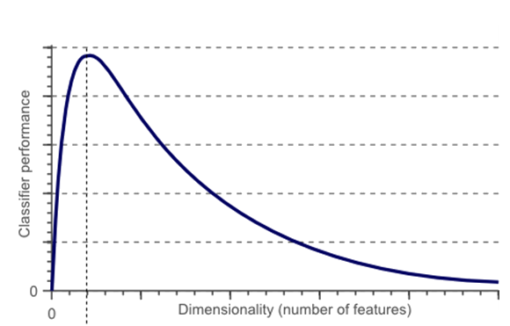
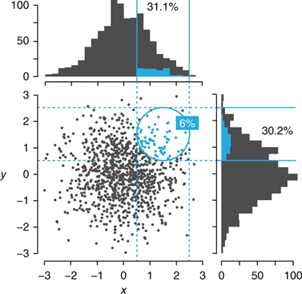
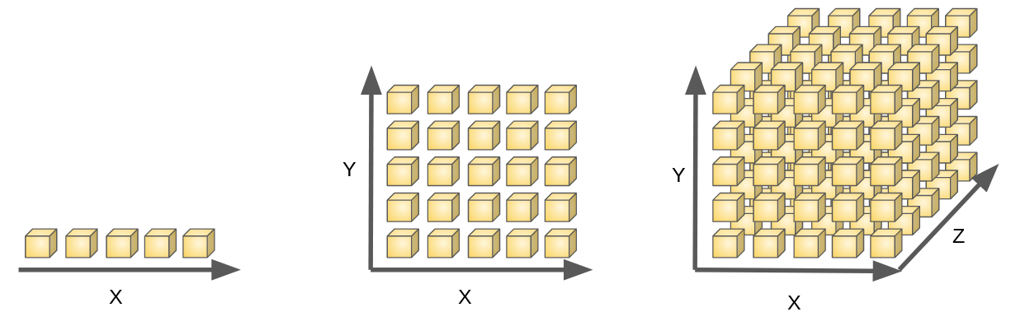
Motivation
Categorical | Animal
 | Cow
 | Tuna
 | ⁝
 | Frog
Binary | Tuna | Cat | Frog | Cod | Goat | Dog | … | Cow
 | 0 | 0 | 0 | 0 | 0 | 0 |  | 1
 | 1 | 0 | 0 | 0 | 0 | 0 |  | 0
 | ⁝ | ⁝ | ⁝ | ⁝ | ⁝ | ⁝ |  | ⁝
 | 0 | 0 | 1 | 0 | 0 | 0 |  | 1
OneHot Encoding
Notes:
當類別變數中的種類過多時，將會大幅度的增加總體特徵總數
但同時資料也提升至了更高的維度，如此將造成多重共線性、並行性等問題
並甚至難以有效計算樣本之間的歐式距離
最終使模型難以對樣本作出有效歸納，導致模型表現的下滑

Slide 8
Motivation
Categorical | Animal | Size | Color
 | Cow | Big | White
 | Tuna | Med | Black
 | ⁝ | ⁝ | ⁝
 | Frog | Tiny | Green
Other Encoding
Numerical | Animal | Size | Color
 | 10 | 4 | 7
 | 2 | 3 | 6
 | ⁝ | ⁝ | ⁝
 | 7 | 1 | 3
One Hot
Binary | Animal |  |  |  |  |  |  |  | Size |  |  |  | Color
 | Tuna | Cat | Frog | Cod | Goat | Dog | Toad | Cow | Large | Mid | Small | Tiny | White | Black | Red | Blue | Green | Gray
 | 0 | 0 | 0 | 0 | 0 | 0 | 0 | 1 | 1 | 0 | 0 | 0 | 1 | 0 | 0 | 0 | 0 | 0
 | 1 | 0 | 0 | 0 | 0 | 0 | 0 | 0 | 0 | 1 | 0 | 0 | 0 | 1 | 0 | 0 | 0 | 0
 | ⁝ | ⁝ | ⁝ | ⁝ | ⁝ | ⁝ | ⁝ | ⁝ | ⁝ | ⁝ | ⁝ | ⁝ | ⁝ | ⁝ | ⁝ | ⁝ | ⁝ | ⁝
 | 0 | 0 | 1 | 0 | 0 | 0 | 0 | 1 | 0 | 0 | 0 | 1 | 0 | 0 | 0 | 0 | 1 | 0
Notes:
於是，當遭遇具有多種類的類別特徵時，
最好便改用其他的編碼方式，像是ordinal, target encoding等固定特徵個數方法如此一來便能避免上述的問題發生
在此圖中可以看到，onehot, binary encoding將類別資料轉變為二元資料，
而傳統的編碼方式則將類別資料轉變為數值資料

Slide 9
Motivation
Categorical | Animal | Size | Color
 | Cow | Big | White
 | Tuna | Med | Black
 | ⁝ | ⁝ | ⁝
 | Frog | Tiny | Green
Other Encoding
Numerical | Animal | Size | Color
 | 10 | 4 | 7
 | 2 | 3 | 6
 | ⁝ | ⁝ | ⁝
 | 7 | 1 | 3
Binary
 | Tuna | Cat | Frog | Cod | Goat | Dog | Toad | Cow | Large | Mid | Small | Tiny | White | Black | Red | Blue | Green | Gray
 | 0 | 0 | 0 | 0 | 0 | 0 | 0 | 1 | 1 | 0 | 0 | 0 | 1 | 0 | 0 | 0 | 0 | 0
 | 1 | 0 | 0 | 0 | 0 | 0 | 0 | 0 | 0 | 1 | 0 | 0 | 0 | 1 | 0 | 0 | 0 | 0
 | ⁝ | ⁝ | ⁝ | ⁝ | ⁝ | ⁝ | ⁝ | ⁝ | ⁝ | ⁝ | ⁝ | ⁝ | ⁝ | ⁝ | ⁝ | ⁝ | ⁝ | ⁝
 | 0 | 0 | 1 | 0 | 0 | 0 | 0 | 1 | 0 | 0 | 0 | 1 | 0 | 0 | 0 | 0 | 1 | 0
Notes:
但，如果今天的第一手資料為二元型別的高維度資料呢？
目前缺乏將二元資料轉換為數值資料的編碼方式
且如果該資料不符合onehot encoding原則，缺乏特徵間的群組資訊
無法轉為類別資料，再經由別的變數編碼處理

Slide 10


Motivation
Numerical | Group 1 | Group 2 | Group 3
 | 10 | 4 | 7
 | 2 | 3 | 6
 | ⁝ | ⁝ | ⁝
 | 7 | 1 | 3
Binary | Tuna | Cat | Frog | Cod | Goat | Dog | Toad | Cow | Large | Mid | Small | Tiny | White | Black | Red | Blue | Green | Gray
 | 0 | 0 | 0 | 0 | 0 | 0 | 0 | 1 | 1 | 0 | 0 | 0 | 1 | 0 | 0 | 0 | 0 | 0
 | 1 | 0 | 0 | 0 | 0 | 0 | 0 | 0 | 0 | 1 | 0 | 0 | 0 | 1 | 0 | 0 | 0 | 0
 | ⁝ | ⁝ | ⁝ | ⁝ | ⁝ | ⁝ | ⁝ | ⁝ | ⁝ | ⁝ | ⁝ | ⁝ | ⁝ | ⁝ | ⁝ | ⁝ | ⁝ | ⁝
 | 0 | 0 | 1 | 0 | 0 | 0 | 0 | 1 | 0 | 0 | 0 | 1 | 0 | 0 | 0 | 0 | 1 | 0
Notes:
發展針對二元資料的編碼方式，協助高維度二元資料轉換為數值資料
而在降低維度的同時，維持新資料對於模型的分類、或是回歸分類表現
即為本研究的主旨

Slide 11
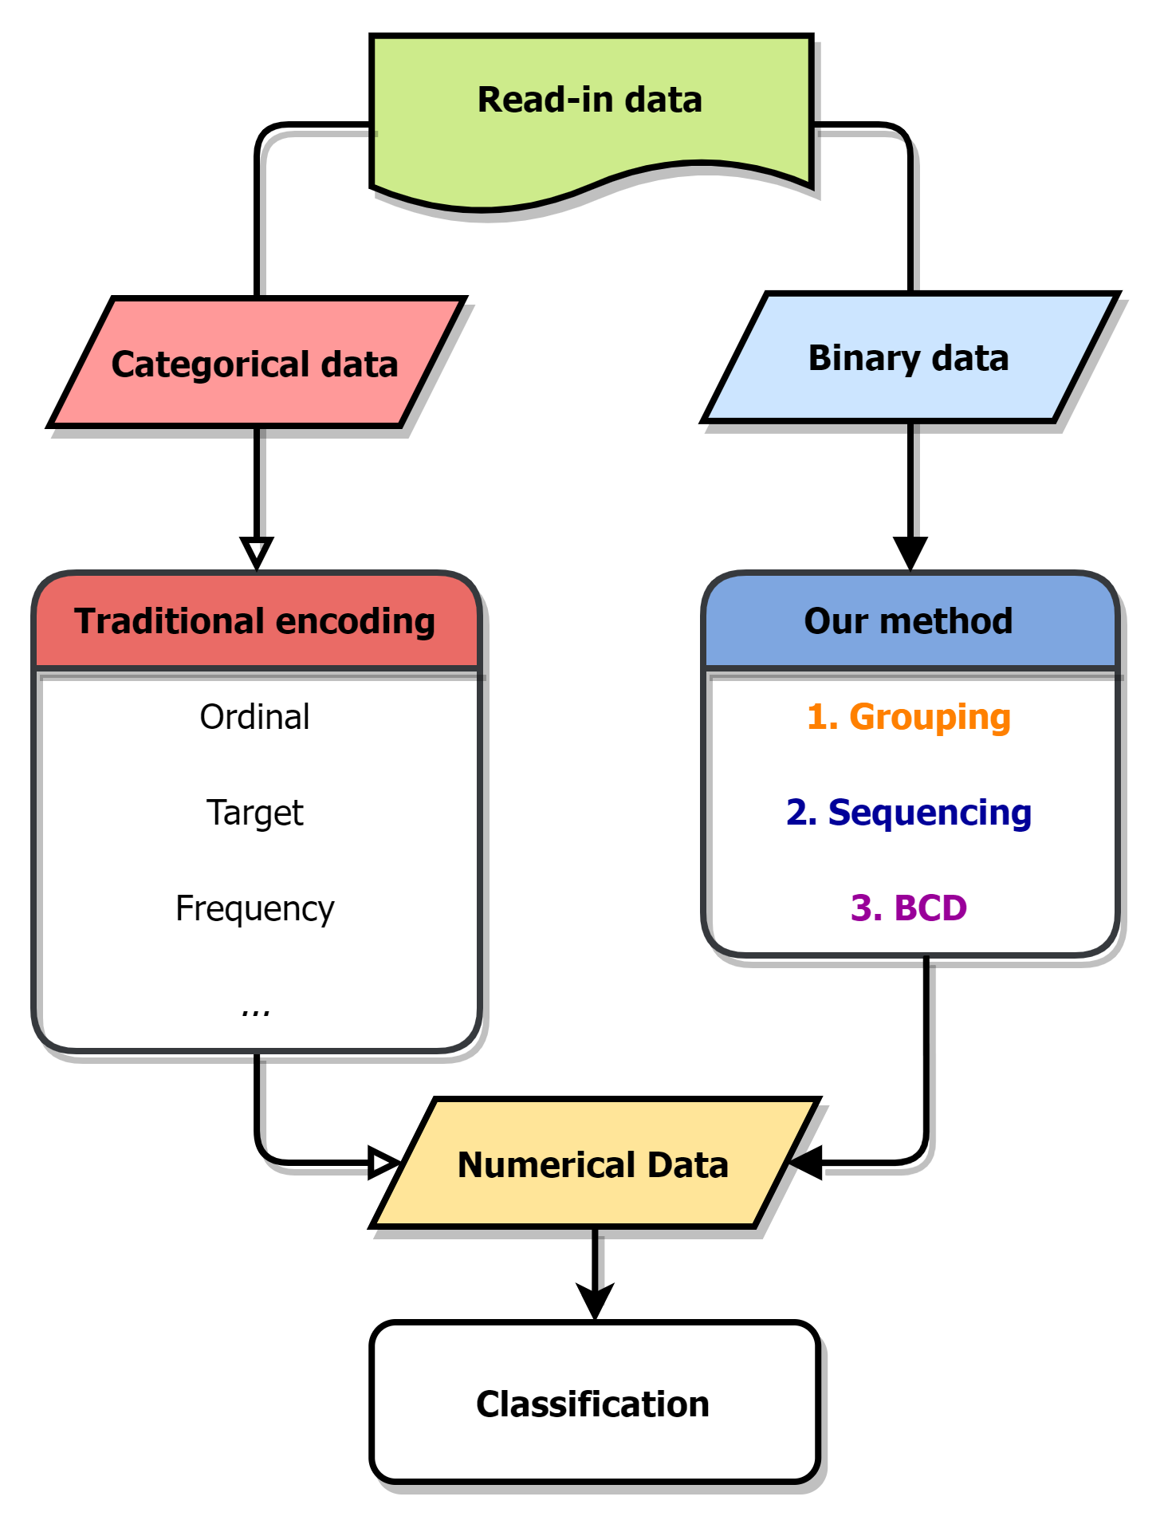
Methodology
Col 6 | Col 2 | Col 5 | Col 4 | Col 1 | Col 3
0 | 1 | 0 | 1 | 1 | 0
0 | 0 | 1 | 1 | 1 | 0
⁝ | ⁝ | ⁝ | ⁝ | ⁝ | ⁝
1 | 0 | 1 | 0 | 0 | 1
Notes:
相比於傳統變數編碼，本研究設法開發針對二元資料的編碼方式

Slide 12
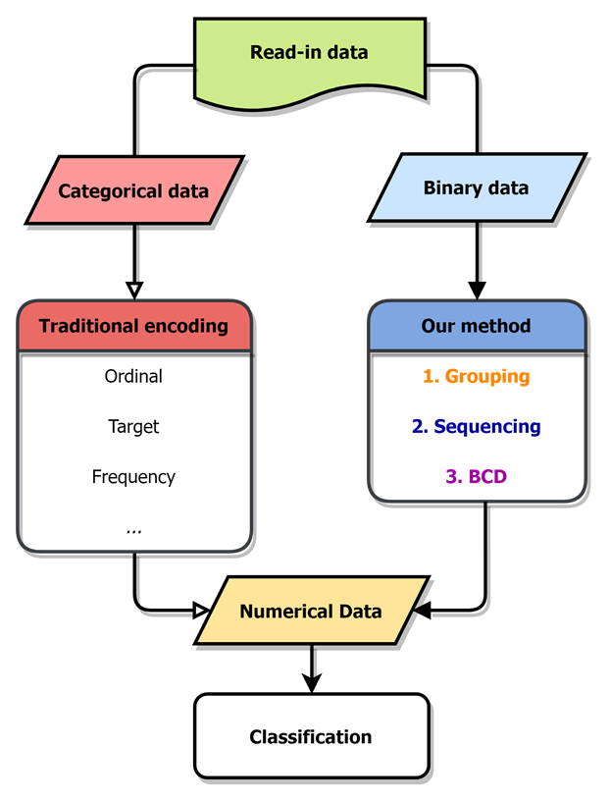
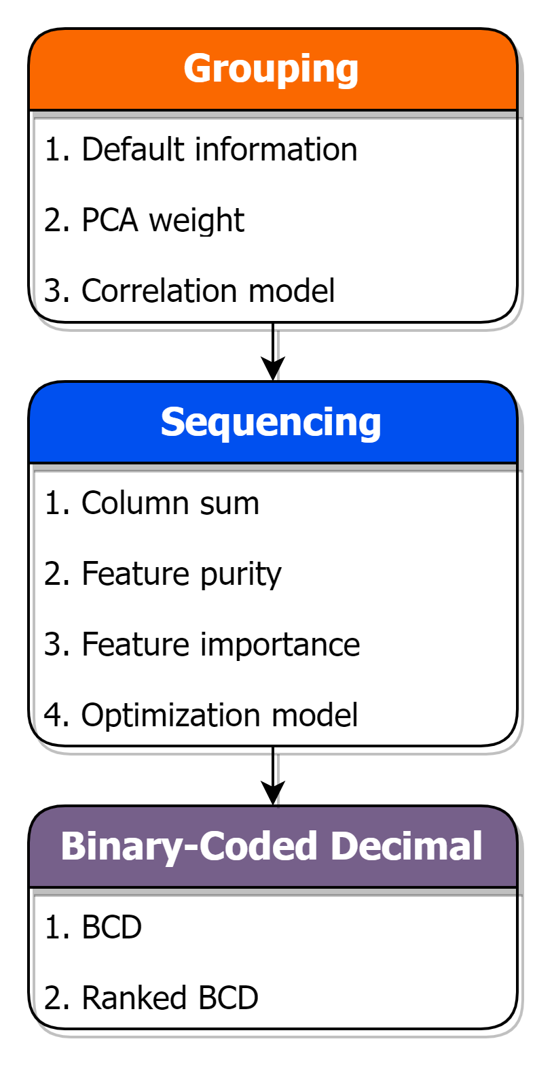
Methodology
Notes:
依序透過群組、排序以及Binary-coded decimal，簡稱為BCD碼的方式
將高維度二元資料轉換為特定維度的數值資料
不同步驟底下有著各不相同的條目，乃是截止目前本研究所提出、嘗試的方法
像在群組方法中，便嘗試了根據PCA權重、或相關係數模型來進行群組

Slide 13
Methodology
Group
Sequence
BCD
Col 1 | Col 2 | Col 3 | Col 4 | Col 5 | Col 6
1 | 1 | 0 | 1 | 0 | 0
1 | 0 | 0 | 1 | 1 | 0
⁝ | ⁝ | ⁝ | ⁝ | ⁝ | ⁝
0 | 0 | 1 | 0 | 1 | 1
We propose a method to encode binary data into numerical data in the research. Via grouping, sequencing, and transforming the binary row data with BCD encode.
Grouping similar, correlated features
Sequencing features in each feature group
BCD encode on each feature group
Tiny | Cat | Large | Black | White | Cow
1 | 1 | 0 | 1 | 0 | 0
0 | 0 | 1 | 0 | 1 | 1
⁝ | ⁝ | ⁝ | ⁝ | ⁝ | ⁝
0 | 0 | 1 | 0 | 1 | 1
Notes:
以下將由動畫的方式簡單帶過整個編碼流程
假設以此六個維度的二元資料作為方法輸入
資料中分別有2個動物、尺寸、顏色特徵
，但無法得知特徵間具有的此類關聯關係

Slide 14
Methodology
Group
Sequence
BCD
We propose a method to encode binary data into numerical data in the research. Via grouping, sequencing, and transforming the binary row data with BCD encode.
Grouping similar, correlated features
Sequencing features in each feature group
BCD encode on each feature group
Tiny
1
0
⁝
0
Cat
1
0
⁝
0
Large
0
1
⁝
1
Black
1
0
⁝
0
White
0
1
⁝
1
Cow
0
1
⁝
1
Notes:
第一步便是群組，目標即為找出特徵間的關聯關係
並將相互關聯、或相似的特徵，規納入同一群組之中

Slide 15
Methodology
Group
Sequence
BCD
We propose a method to encode binary data into numerical data in the research. Via grouping, sequencing, and transforming the binary row data with BCD encode.
Grouping similar, correlated features
Sequencing features in each feature group
BCD encode on each feature group
Cat
1
0
⁝
0
Cow
0
1
⁝
1
Black
1
0
⁝
0
White
0
1
⁝
1
Tiny
1
0
⁝
0
Large
0
1
⁝
1
Notes:
第二步為排序，在各群組內部調動組內特徵
此步驟的是為了產生出更加有競爭力、有助於分類或回歸任務的數值特徵
詳細的方法與原理將在後續提及

Slide 16
Methodology
Group
Sequence
BCD
We propose a method to encode binary data into numerical data in the research. Via grouping, sequencing, and transforming the binary row data with BCD encode.
Grouping similar, correlated features
Sequencing features in each feature group
BCD encode on each feature group
Cow | Cat | White | Black | Tiny | Large
0 | 1 | 0 | 1 | 1 | 0
1 | 0 | 1 | 0 | 0 | 1
⁝ | ⁝ | ⁝ | ⁝ | ⁝ | ⁝
1 | 0 | 1 | 0 | 0 | 1

Slide 17
Methodology
Group
Sequence
BCD
We propose a method to encode binary data into numerical data in the research. Via grouping, sequencing, and transforming the binary row data with BCD encode.
Grouping similar, correlated features
Sequencing features in each feature group
BCD encode on each feature group
Animal | Color | Size
1 | 1 | 2
2 | 2 | 1
⁝ | ⁝ | ⁝
2 | 2 | 1
Notes:
最後一步則是進行BCD編碼，將排序過後的組內複數二元特徵轉變為數值的形式
經由此三步驟之後，便完成了整個編碼過程

Slide 18
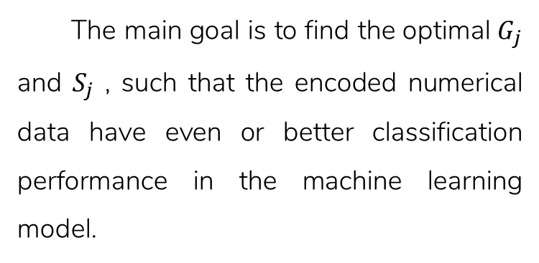
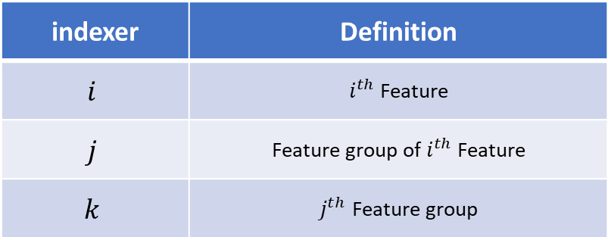
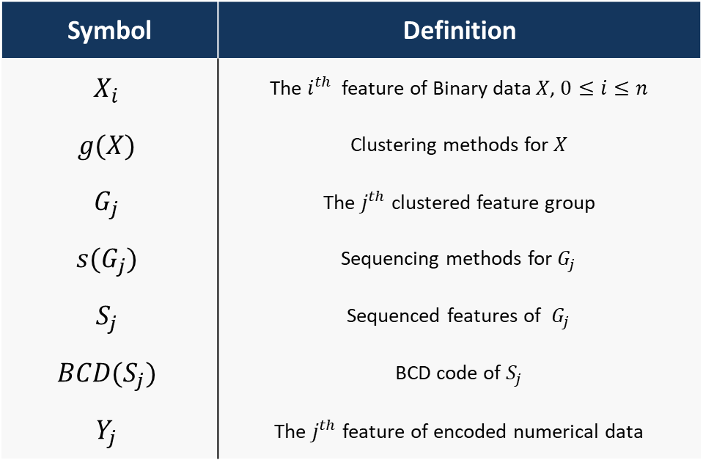
Methodology -problem definition
The main goal is to find the optimal $G_{j}$ and $S_{j}$ , such that the encoded numerical data have even or better classification performance in the machine learning model.
Symbol | Definition
$$X_{i}$$ | The $i^{th}$ feature of Binary data $X$, $0≤i≤n$
$$g(X)$$ | Clustering methods for $X$
$$G_{j}$$ | The $j^{th}$ clustered feature group
$$s(G_{j})$$ | Sequencing methods for $G_{j}$
$$S_{j}$$ | Sequenced features of $G_{j}$
$$BCD(S_{j})$$ | BCD code of $S_{j}$
$$Y_{j}$$ | The $j^{th}$ feature of encoded numerical data
indexer | Definition
$$i$$ | $i^{th}$ Feature
$$j$$ | Feature group of $i^{th}$ Feature
$$k$$ | $j^{th}$ Feature group
Notes:
簡而言之，本研究著重在於尋找出最佳的群組、以及排序方式
以達到縮減資料特徵數、壓縮特徵資訊、以及維持或提升編碼過後資料的分類表現

Slide 19
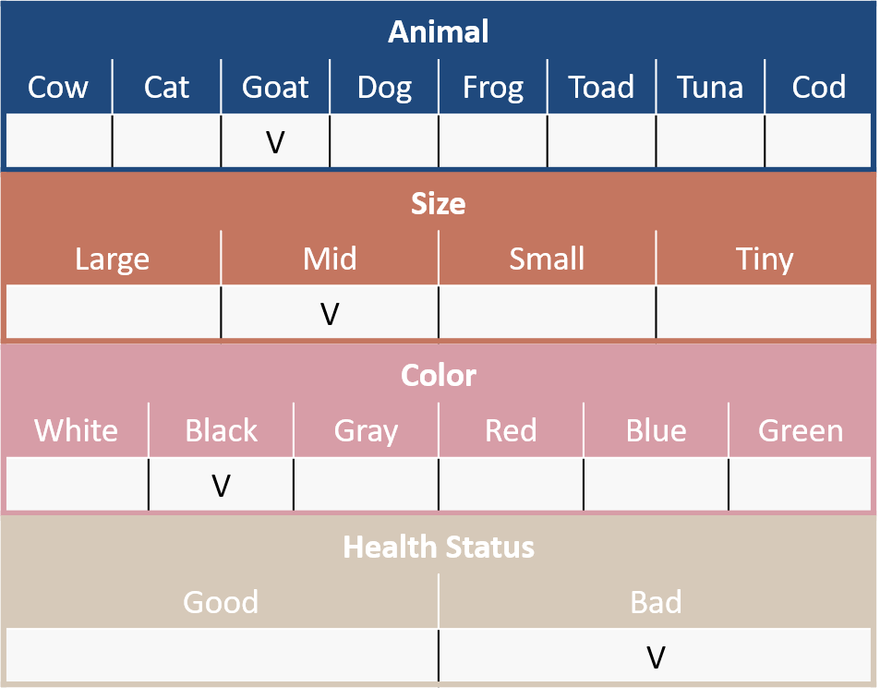
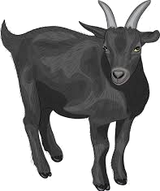



Methodology -An animal health check
Animal
Cow | Cat | Goat | Dog | Frog | Toad | Tuna | Cod
 |  | V
Size
Large | Mid | Small | Tiny
 | V
Color
White | Black | Gray | Red | Blue | Green
 | V
Health Status
Good | Bad
 | V
Notes:
在此將以一個簡單案例為題
假設我們為動物園管理者，需要對園區中的各式生物進行健康檢測
可見其中包含了物種、尺寸、顏色以及健康狀態的欄位
，且欄位中的各選項相互互斥
任務為依據物種、尺寸、顏色，對健康狀態作出預測

Slide 20
Methodology -An animal health check
Binary Data (Total:300 samples, 200 good, 100 bad)
Animal
Cow | Cat | Goat | Dog | Frog | Toad | Tuna | Cod
 |  | V
Size
Large | Mid | Small | Tiny
 | V
Color
White | Black | Gray | Red | Blue | Green
 | V
Health Status
Good | Bad
 | V
Notes:
當在蒐集了300隻園中動物的資料後，可以得到右方的堆疊直方圖
直方圖以紅、藍兩色作為生病、與健康的標示，表示了在各個選項之中被勾選的動物數量
像是在尺寸:中等的選項中，共有接近100隻的動物，且這100隻動物中有一半50隻為健康、另一半為生病
而任務便是以這18個二元選項作為特徵，來預測動物的健康狀態

Slide 21
Methodology -An animal health check
Binary Data (Total:300 samples, 200 good, 100 bad)
Animal | Cow | Cat | Goat | Dog | Frog | … | Blue | Green
#1 | 0 | 1 | 0 | 0 | 0 | … | 0 | 0
#2 | 1 | 0 | 0 | 0 | 0 | … | 0 | 0
#3 | 0 | 0 | 0 | 0 | 0 | … | 0 | 0
#4 | 0 | 0 | 0 | 0 | 0 | … | 0 | 0
#5 | 0 | 0 | 1 | 0 | 0 | … | 0 | 0
#6 | 0 | 0 | 0 | 0 | 1 | … | 0 | 0
#7 | 0 | 0 | 0 | 0 | 0 | … | 0 | 0
⁝ | ⁝ | ⁝ | ⁝ | ⁝ | ⁝ | ⁝ | ⁝ | ⁝
#300 | 0 | 0 | 0 | 1 | 0 | … | 0 | 0
Animal
Cow | Cat | Goat | Dog | Frog | Toad | Tuna | Cod
 |  | V
Size
Large | Mid | Small | Tiny
 | V
Color
White | Black | Gray | Red | Blue | Green
 | V
Health Status
Good | Bad
 | V
Notes:
我們也可以將直方圖改為表格形式
仍相同代表著園中300動物在這18個選項之中的勾選狀態

Slide 22
Methodology -Grouping
Group
Sequence
BCD
Binary Data (Total:300 sample, 200 good, 100 bad)
First, try to find the relationship of these binary features, then cluster those related, correlated features.
Default information
PCA weight
Correlation model
K-means
Hierarchical clustering
Block modeling
Notes:
首先，將針對這18個二元特徵進行群組，除了依照原先的欄位群組外，
本研究已嘗試使用PCA權重、聚類模型結合相關係數的方式來完成任務
以下投影片將簡介如何以PCA, 區塊模型群組特徵

Slide 23
Methodology -PCA Grouping
Group
Sequence
BCD
No. | PC 1 |  |  | PC 2 |  |  | PC 3
 | Feature | Abs. weight | select | Feature | Abs. weight | select | Feature | Abs. weight | select
1. | Cow | 0.562 | O | Cat | 0.642 | X | Black | 0.047 | X
2. | Cat | 0.486 | O | Cow | 0.496 | X | Goat | 0.035 | X
3. | Large | 0.348 | O | Mid | 0.402 | X | Cat | 0.032 | X
4. | Mid | 0.311 | O | Black | 0.351 | X | Cow | 0.030 | X
5. | White | 0.307 | O | Goat | 0.302 | O | Mid | 0.028 | X
6. | Black | 0.202 | O | Dog | 0.229 | O | Gray | 0.023 | X
7. | Small | 0.187 | X | Large | 0.199 | X | White | 0.021 | X
8. | Goat | 0.153 | X | Frog | 0.183 | O | Dog | 0.020 | X
9. | Cod | 0.101 | X | Small | 0.152 | O | Large | 0.018 | X
10. | Tuna | 0.091 | X | Gray | 0.132 | O | Frog | 0.016 | X
11. | Dog | 0.074 | X | White | 0.105 | X | Small | 0.014 | X
12. | Gray | 0.060 | X | Red | 0.008 | O | Toad | 0.014 | O
13. | Frog | 0.056 | X | Frog | 0.008 | X | Tuna | 0.012 | O
14. | Toad | 0.032 | X | Red | 0.007 | X | Cod | 0.007 | O
15. | Red | 0.029 | X | Toad | 0.005 | X | Red | 0.005 | X
16. | Tiny | 0.023 | X | Green | 0.001 | X | Tiny | 0.002 | O
17. | Green | 0.015 | X | Tiny | 0.001 | X | Blue | 0.001 | O
18. | Blue | 0.009 | X | Blue | 0.001 | X | Green | 0.001 | O
Notes:
首先是針對PCA權重的群組方式
透過前3個主成分列舉特徵權重絕對值，並依照主成分順序依序選擇前六個特徵進入同一群組中
若預選取特徵已被前方主成分選取，則跳過並依序選則下一個，如PC1與PC2

Slide 24
Methodology -PCA Grouping
Group
Sequence
BCD
No. | PC 1 |  |  | PC 2 |  |  | PC 3
 | Feature | Abs. weight | select | Feature | Abs. weight | select | Feature | Abs. weight | select
1. | Cow | 0.562 | O | Cat | 0.642 | X | Black | 0.047 | X
2. | Cat | 0.486 | O | Cow | 0.496 | X | Goat | 0.035 | X
3. | Large | 0.348 | O | Mid | 0.402 | X | Cat | 0.032 | X
4. | Mid | 0.311 | O | Black | 0.351 | X | Cow | 0.030 | X
5. | White | 0.307 | O | Goat | 0.302 | O | Mid | 0.028 | X
6. | Black | 0.202 | O | Dog | 0.229 | O | Gray | 0.023 | X
7. | Small | 0.187 | X | Large | 0.199 | X | White | 0.021 | X
8. | Goat | 0.153 | X | Frog | 0.183 | O | Dog | 0.020 | X
9. | Cod | 0.101 | X | Small | 0.152 | O | Large | 0.018 | X
10. | Tuna | 0.091 | X | Gray | 0.132 | O | Frog | 0.016 | X
11. | Dog | 0.074 | X | White | 0.105 | X | Small | 0.014 | X
12. | Gray | 0.060 | X | Red | 0.008 | O | Toad | 0.014 | O
13. | Frog | 0.056 | X | Frog | 0.008 | X | Tuna | 0.012 | O
14. | Toad | 0.032 | X | Red | 0.007 | X | Cod | 0.007 | O
15. | Red | 0.029 | X | Toad | 0.005 | X | Red | 0.005 | X
16. | Tiny | 0.023 | X | Green | 0.001 | X | Tiny | 0.002 | O
17. | Green | 0.015 | X | Tiny | 0.001 | X | Blue | 0.001 | O
18. | Blue | 0.009 | X | Blue | 0.001 | X | Green | 0.001 | O
Notes:
透過主成分分析可以將最能解釋整體資料變異、最具資訊的二元特徵分於相同群組之內
，而最無法解釋變異的特徵也將被劃分入同一群內，
其想法類似於能力分班的概念，將強者群與弱者群相互隔離，便於後續進行特徵選取

Slide 25
Methodology -Block modeling Grouping
Group
Sequence
BCD
 | Tuna | Cat | Frog | Cod | Goat | Dog | Toad | Cow | Large | Mid | Small | Tiny | White | Black | Red | Blue | Green | Gray
Tuna | 1.0 | 0.2 | 0.2 | 0.8 | 0.2 | 0.2 | 0.8 | 0.2 | 0.1 | 0.1 | 0.1 | 0.3 | 0.0 | 0.0 | 0.0 | 0.5 | 0.5 | 0.0
Cat | 0.2 | 1.0 | 0.2 | 0.2 | 0.2 | 0.2 | 0.2 | 0.8 | 0.3 | 0.3 | 0.1 | 0.1 | 0.2 | 0.2 | 0.0 | 0.0 | 0.0 | 0.0
Frog | 0.2 | 0.2 | 1.0 | 0.2 | 0.8 | 0.8 | 0.2 | 0.2 | 0.1 | 0.1 | 0.3 | 0.1 | 0.0 | 0.0 | 0.3 | 0.0 | 0.0 | 0.3
Cod | 0.8 | 0.2 | 0.2 | 1.0 | 0.2 | 0.2 | 0.8 | 0.8 | 0.1 | 0.1 | 0.1 | 0.3 | 0.0 | 0.0 | 0.0 | 0.3 | 0.3 | 0.0
Goat | 0.2 | 0.2 | 0.8 | 0.2 | 1.0 | 0.8 | 0.2 | 0.2 | 0.1 | 0.1 | 0.3 | 0.1 | 0.0 | 0.0 | 0.3 | 0.0 | 0.0 | 0.3
Dog | 0.2 | 0.2 | 0.8 | 0.2 | 0.8 | 1.0 | 0.2 | 0.2 | 0.1 | 0.1 | 0.3 | 0.1 | 0.0 | 0.0 | 0.3 | 0.0 | 0.0 | 0.3
Toad | 0.8 | 0.2 | 0.2 | 0.8 | 0.2 | 0.2 | 1.0 | 0.2 | 0.1 | 0.1 | 0.1 | 0.3 | 0.0 | 0.0 | 0.0 | 0.3 | 0.0 | 0.0
Cow | 0.2 | 0.8 | 0.2 | 0.8 | 0.2 | 0.2 | 0.2 | 1.0 | 0.3 | 0.3 | 0.1 | 0.1 | 0.3 | 0.3 | 0.0 | 0.0 | 0.0 | 0.0
Large | 0.1 | 0.3 | 0.1 | 0.1 | 0.1 | 0.1 | 0.1 | 0.3 | 1.0 | 0.5 | 0.1 | 0.1 | 0.6 | 0.6 | 0.2 | 0.2 | 0.2 | 0.2
Mid | 0.1 | 0.3 | 0.1 | 0.1 | 0.1 | 0.1 | 0.1 | 0.3 | 0.5 | 1.0 | 0.1 | 0.1 | 0.6 | 0.6 | 0.2 | 0.2 | 0.2 | 0.2
Small | 0.1 | 0.1 | 0.3 | 0.1 | 0.3 | 0.3 | 0.1 | 0.1 | 0.1 | 0.1 | 1.0 | 0.1 | 0.2 | 0.2 | 0.6 | 0.2 | 0.2 | 0.6
Tiny | 0.3 | 0.1 | 0.1 | 0.3 | 0.1 | 0.1 | 0.3 | 0.1 | 0.1 | 0.1 | 0.1 | 1.0 | 0.2 | 0.2 | 0.2 | 0.6 | 0.2 | 0.2
White | 0.0 | 0.2 | 0.0 | 0.0 | 0.0 | 0.0 | 0.0 | 0.3 | 0.6 | 0.6 | 0.2 | 0.2 | 1.0 | 0.8 | 0.4 | 0.4 | 0.4 | 0.4
Black | 0.0 | 0.2 | 0.0 | 0.0 | 0.0 | 0.0 | 0.0 | 0.3 | 0.6 | 0.6 | 0.2 | 0.2 | 0.8 | 1.0 | 0.4 | 0.4 | 0.4 | 0.8
Red | 0.0 | 0.0 | 0.3 | 0.0 | 0.3 | 0.3 | 0.0 | 0.0 | 0.2 | 0.2 | 0.6 | 0.2 | 0.4 | 0.4 | 1.0 | 0.4 | 0.4 | 0.4
Blue | 0.5 | 0.0 | 0.0 | 0.3 | 0.0 | 0.0 | 0.3 | 0.0 | 0.2 | 0.2 | 0.2 | 0.6 | 0.4 | 0.4 | 0.4 | 1.0 | 0.8 | 0.8
Green | 0.5 | 0.0 | 0.0 | 0.3 | 0.0 | 0.0 | 0.0 | 0.0 | 0.2 | 0.2 | 0.2 | 0.2 | 0.4 | 0.4 | 0.4 | 0.8 | 1.0 | 0.4
Gray | 0.0 | 0.0 | 0.3 | 0.0 | 0.3 | 0.3 | 0.0 | 0.0 | 0.2 | 0.2 | 0.6 | 0.2 | 0.4 | 0.8 | 0.4 | 0.8 | 0.4 | 1.0
Notes:
以區塊模型結合相關係數的方式
列舉出特徵與特徵間的相關係數圖之後，便嘗試調動順序，
使整張相關係數圖區分出不同的聚類

Slide 26
Methodology -Block modeling Grouping
Group
Sequence
BCD
 | Cow | Cat | Large | Mid | White | Black | Goat | Dog | Frog | Small | Gray | Red | Toad | Tuna | Cod | Tiny | Blue | Green
Cow | 1.0 | 0.8 | 0.3 | 0.3 | 0.5 | 0.5 | 0.2 | 0.2 | 0.2 | 0.1 | 0.0 | 0.0 | 0.2 | 0.2 | 0.2 | 0.1 | 0.0 | 0.0
Cat | 0.8 | 1.0 | 0.3 | 0.3 | 0.5 | 0.5 | 0.2 | 0.2 | 0.2 | 0.1 | 0.0 | 0.0 | 0.2 | 0.2 | 0.2 | 0.1 | 0.0 | 0.0
Large | 0.3 | 0.3 | 1.0 | 0.5 | 0.6 | 0.6 | 0.1 | 0.1 | 0.1 | 0.1 | 0.2 | 0.2 | 0.1 | 0.1 | 0.1 | 0.1 | 0.2 | 0.2
Mid | 0.3 | 0.3 | 0.5 | 1.0 | 0.6 | 0.6 | 0.1 | 0.1 | 0.1 | 0.1 | 0.2 | 0.2 | 0.1 | 0.1 | 0.1 | 0.1 | 0.2 | 0.2
White | 0.5 | 0.5 | 0.6 | 0.6 | 1.0 | 0.8 | 0.0 | 0.0 | 0.0 | 0.2 | 0.4 | 0.4 | 0.0 | 0.0 | 0.0 | 0.2 | 0.4 | 0.4
Black | 0.5 | 0.5 | 0.6 | 0.6 | 0.8 | 1.0 | 0.0 | 0.0 | 0.0 | 0.2 | 0.4 | 0.4 | 0.0 | 0.0 | 0.0 | 0.2 | 0.4 | 0.4
Goat | 0.2 | 0.2 | 0.1 | 0.1 | 0.0 | 0.0 | 1.0 | 0.8 | 0.8 | 0.3 | 0.3 | 0.3 | 0.2 | 0.2 | 0.2 | 0.1 | 0.0 | 0.0
Dog | 0.2 | 0.2 | 0.1 | 0.1 | 0.0 | 0.0 | 0.8 | 1.0 | 0.8 | 0.3 | 0.5 | 0.5 | 0.2 | 0.2 | 0.2 | 0.1 | 0.0 | 0.0
Frog | 0.2 | 0.2 | 0.1 | 0.1 | 0.0 | 0.0 | 0.8 | 0.8 | 1.0 | 0.3 | 0.5 | 0.5 | 0.2 | 0.2 | 0.2 | 0.1 | 0.0 | 0.0
Small | 0.1 | 0.1 | 0.1 | 0.1 | 0.2 | 0.2 | 0.3 | 0.3 | 0.3 | 1.0 | 0.6 | 0.6 | 0.1 | 0.1 | 0.1 | 0.1 | 0.2 | 0.2
Gray | 0.0 | 0.0 | 0.2 | 0.2 | 0.4 | 0.4 | 0.3 | 0.5 | 0.5 | 0.6 | 1.0 | 0.8 | 0.0 | 0.0 | 0.0 | 0.2 | 0.4 | 0.4
Red | 0.0 | 0.0 | 0.2 | 0.2 | 0.4 | 0.4 | 0.3 | 0.5 | 0.5 | 0.6 | 0.8 | 1.0 | 0.0 | 0.0 | 0.0 | 0.2 | 0.4 | 0.4
Toad | 0.2 | 0.2 | 0.1 | 0.1 | 0.0 | 0.0 | 0.2 | 0.2 | 0.2 | 0.1 | 0.0 | 0.0 | 1.0 | 0.8 | 0.8 | 0.3 | 0.5 | 0.5
Tuna | 0.2 | 0.2 | 0.1 | 0.1 | 0.0 | 0.0 | 0.2 | 0.2 | 0.2 | 0.1 | 0.0 | 0.0 | 0.8 | 1.0 | 0.8 | 0.3 | 0.5 | 0.5
Cod | 0.2 | 0.2 | 0.1 | 0.1 | 0.0 | 0.0 | 0.2 | 0.2 | 0.2 | 0.1 | 0.0 | 0.0 | 0.8 | 0.8 | 1.0 | 0.3 | 0.5 | 0.5
Tiny | 0.1 | 0.1 | 0.1 | 0.1 | 0.2 | 0.2 | 0.1 | 0.1 | 0.1 | 0.1 | 0.2 | 0.2 | 0.3 | 0.3 | 0.3 | 1.0 | 0.6 | 0.6
Blue | 0.0 | 0.0 | 0.2 | 0.2 | 0.4 | 0.4 | 0.0 | 0.0 | 0.0 | 0.2 | 0.4 | 0.4 | 0.5 | 0.5 | 0.5 | 0.6 | 1.0 | 0.8
Green | 0.0 | 0.0 | 0.2 | 0.2 | 0.4 | 0.4 | 0.0 | 0.0 | 0.0 | 0.2 | 0.4 | 0.4 | 0.5 | 0.5 | 0.5 | 0.6 | 0.8 | 1.0
Notes:
相同特徵群集下相關性與同質性較高；反之相異特徵群集之間相關形薄弱。
此方式嘗試由相關性，群集較為相似、關聯的二元特徵

Slide 27
Methodology -Grouping
Group
Sequence
BCD
Binary Data | Grouped by PCA
Notes:
在此使用由PCA權重產生的特徵群組
可見在其產生的特徵組中，綜合了不同物種、尺寸與顏色的特徵

Slide 28
Methodology -Sequencing
Group
Sequence
BCD
 | Grouped by PCA
Secondly, sequencing features in each group by columns’ attributes, for outputting better BCD values after encode.
Column sum
Type purity
Feature importance
Notes:
在群組之後，為了使產出後的新數資料更具有目標資訊、與分類價值，
將依據群組內各個特徵本身屬性，排序組內二元特徵，來調整編碼過後所產生的數值。
本研究已嘗試依據二元特徵總和、特徵類別純粹度、預訓練模型的特徵重要性、作為排序依據。

Slide 29
Methodology -Sequencing
Group
Sequence
BCD
Group
Sequence | No Seq.
 | Purity
BCD value
No Seq.
Purity
Notes:
為了驗證排序對於編碼後產生的數值資料是否具有影響，這裡以方才產生的PC3特徵組為例，
對比不進行排序，以及排序後的數值資料差異

Slide 30
Methodology -Sequencing
Group
Sequence
BCD
Group
Sequence | No Seq.
 | Purity
BCD value
No Seq.
Purity
Notes:
右圖呈現的為根據不排序、以及特徵純粹度兩種排序方式後，經由BCD編碼所產生的數值資料
可以看到排序對於編碼數值有著明顯的影響，對於常規的分類模型而言，
下方的數值特徵更可以在數線上找到一個更佳的數值切分點
來區分出紅色與藍色兩種資料，因此能使模型達到較好的分類成果
簡而言之，好的排序將協助模型區分目標類別，而這便是進行排序的原因

Slide 31
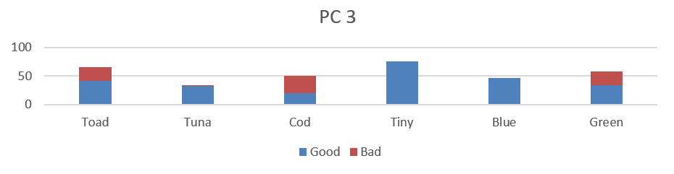
Methodology -Sequencing
Group
Sequence
BCD
Group
Sequence | Sum
 | Purity
Notes:
以方才產生的PC3特徵組為例，此處嘗試排序此群組當中的6個二元特徵

Slide 32
Methodology -Sequencing
Group
Sequence
BCD
Group
Sequence | Sum
 | Purity
Column Sum
Type Purity
Notes:
依據特徵數值總合排序，
二元特徵總合通常表示了的該類別的出現頻率。
該排序目的在於將總和較少的二元特徵置於群組左方，如此那些含有此稀有二元特徵的少量樣本便會在編碼時被投影到離數線原點較遠的位置
以利區分出這些與眾不同、較偏離整體資料分布的離群樣本。

Slide 33
Methodology -Sequencing
Group
Sequence
BCD
Group
Sequence | Sum
 | Purity
Column Sum
Type Purity
Notes:
此則依據特徵類別的純粹度進行排序，為監督式的排序方式
其將最有分類價值、類別純度越高的資料分布於特徵群組的前端、與後端，而中間段的特徵則是最不純粹的
當群組中的二元特徵經由BCD轉換為數值資料時，兩種類別會因為這些被置於前方、含有資訊與分類價值的二元特徵的緣故，編碼出類別間差異巨大的數值資料

Slide 34
Methodology -BCD code
Group
Sequence
BCD
Last, using Binary Coded Decimal to transform feature groups into numerical values.
BCD
Ranked BCD
Decimal digit | BCD
 | 8 | 4 | 2 | 1
0 | 0 | 0 | 0 | 0
1 | 0 | 0 | 0 | 1
2 | 0 | 0 | 1 | 0
3 | 0 | 0 | 1 | 1
4 | 0 | 1 | 0 | 0
5 | 0 | 1 | 0 | 1
6 | 0 | 1 | 1 | 0
7 | 0 | 1 | 1 | 1
8 | 1 | 0 | 0 | 0
9 | 1 | 0 | 0 | 1
Notes:
最後一步便是以Binary coded decimal 的方式，協助轉換特徵組成為整數數值。
本研究所採用8421-BCD，其概念相當直接，即是將一連串的二元數值十位數化。
假設某樣本在一特徵群組內的二元特徵數值依序為0、1、1、0，則其轉換後的十位數數值為6
便以6作為該樣本的新數值特徵

Slide 35
Methodology -BCD code
Group
Sequence
BCD
Group
Sequence
BCD |  | Sorted Column Group |  |  |  |  |  |  | Type
 |  | Blue | Tuna | Tiny | Toad | Green | Cod
33 |  | 1 | 0 | 0 | 0 | 0 | 1 |  | Good
36 |  | 1 | 0 | 0 | 1 | 0 | 0 |  | Good
26 |  | 0 | 1 | 1 | 0 | 1 | 0 |  | Bad
14 |  | 0 | 0 | 1 | 1 | 1 | 0 |  | Bad
Notes:
在此，則以先前已由PCA群組、純粹度排序的特徵組為例

Slide 36
Methodology -BCD code
Group
Sequence
BCD
Group
Sequence
BCD |  | Sequenced features |  |  |  |  |  |  | Type
 |  | Blue | Tuna | Tiny | Toad | Green | Cod
33 |  | 1 | 0 | 0 | 0 | 0 | 1 |  | Good
36 |  | 1 | 0 | 0 | 1 | 0 | 0 |  | Good
26 |  | 0 | 1 | 1 | 0 | 1 | 0 |  | Bad
14 |  | 0 | 0 | 1 | 1 | 1 | 0 |  | Bad
Notes:
可見在Blue這個欄位中，僅具有健康類別的樣本，而此欄位被排序在特徵組的最左側
而愈左側的特徵對於BCD數值大小具有更大的影響；同時採用了特徵純粹度的排序，
越左側的特徵在比例上有著更多的健康樣本。因此，健康樣本傾向於產出更大的BCD數值
反之，生病的樣本傾向於產生較小的BCD數值

Slide 37
Methodology -BCD code
Group
Sequence
BCD
Group
Sequence
BCD |  | Sequenced features |  |  |  |  |  |  | Type
 |  | Blue | Tuna | Tiny | Toad | Green | Cod
33 |  | 1 | 0 | 0 | 0 | 0 | 1 |  | Good
36 |  | 1 | 0 | 0 | 1 | 0 | 0 |  | Good
26 |  | 0 | 1 | 1 | 0 | 1 | 0 |  | Bad
14 |  | 0 | 0 | 1 | 1 | 1 | 0 |  | Bad
Notes:
如此一來，在經由BCD編碼之後，經由純粹度排序的特徵組
相比於原先的群組順序而言，更能導出容易區分類別的數值資料
因此能達到較好的分類成果。
如果能設法找尋出好的特徵排序方式，
對於新數值資料的分類任務將有莫大的幫助。

Slide 38
Methodology -BCD code
Group
Sequence
BCD
Notes:
然而，新編碼過後BCD數值也可能因為原先數字1的分布稀疏，也將導致編碼後的數值資料全距過大、且分布稀疏。
例如：若組內二元特徵的個數為十個，則此群組編碼出的新數值特徵範圍將達到0至1024之間。
而在這0至1024的數線之上的資料呈現零散分佈

Slide 39
Methodology -BCD code
Group
Sequence
BCD
Notes:
為此，可嘗試透過Ranked BCD排名編碼，根據BCD大小進行排序，以取代原先的數值
在改善編碼後資料之間的稀疏程度的同時，也能避免儲存過大正整數，因而導致整數溢位等問題
但對於分類模型而言，僅需在數線上決定切分點，不論資料全距，兩者的差異對分類模型的影響並不是相當顯著

Slide 40
Methodology -sum up
1. | Grouping
 | Clustering related or similar columns together into groups.
2. | Sequencing
 | Rearrange columns in the group for a more distinctive /competitive BCD value.
3. | Binary-Coded Decimal
 | Transform column groups into a numerical value with BCD.
Original
Randomly
Impurity
Notes:
以上便是本研究方法的詳細介紹，並於此進行研究方法的小結
首先第一步驟是依照聚類、或是特徵選取的方式群組二元特徵
並接著對各個特徵組內的二元特徵進行一致性的排序，
以求產生出有著更具有判別性、分類優勢的整數資料
最後藉由Binary coded decimal，協助轉換各個二元特徵組成為整數特徵

Slide 41
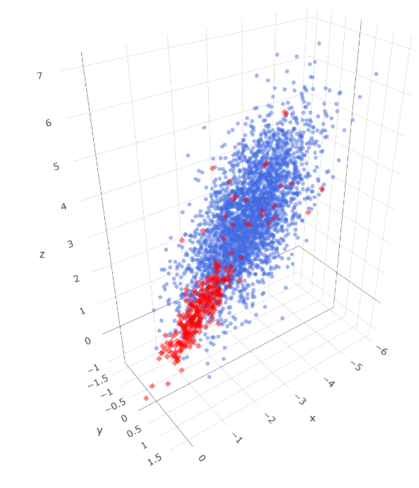


Case study
In the Case study, we compare classification results with the commonly used variable encoding method under different datasets.
Simulated continuous datasets
UCI-Car evaluation dataset
Kaggle-Feature encoding challenge dataset
Notes:
為驗證本研究提出之高維二元特徵之聚合編碼技術及分析框架，
透過模擬出三維連續的二元分類資料集；
以及對於UCI，Kaggle等開源資料集平台上的類別特徵資料集進行研討，
以比較傳統變數編碼與所發展之方法產生的新數值資料，對於機器學習模型分類成效之影響。

Slide 42
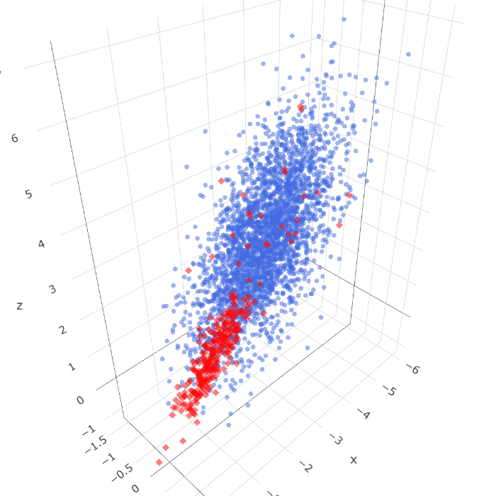
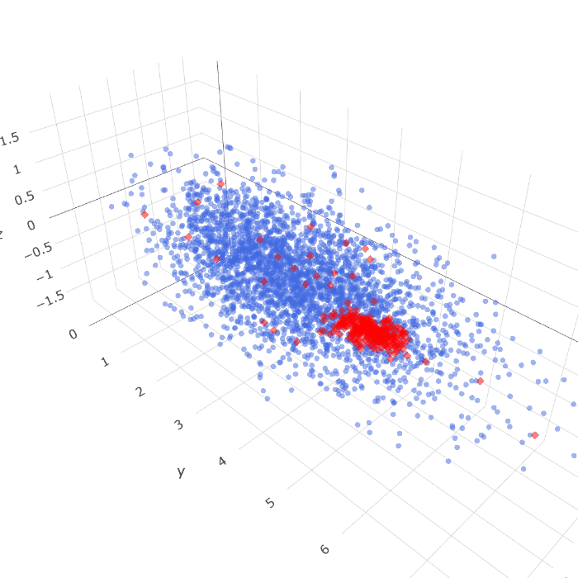
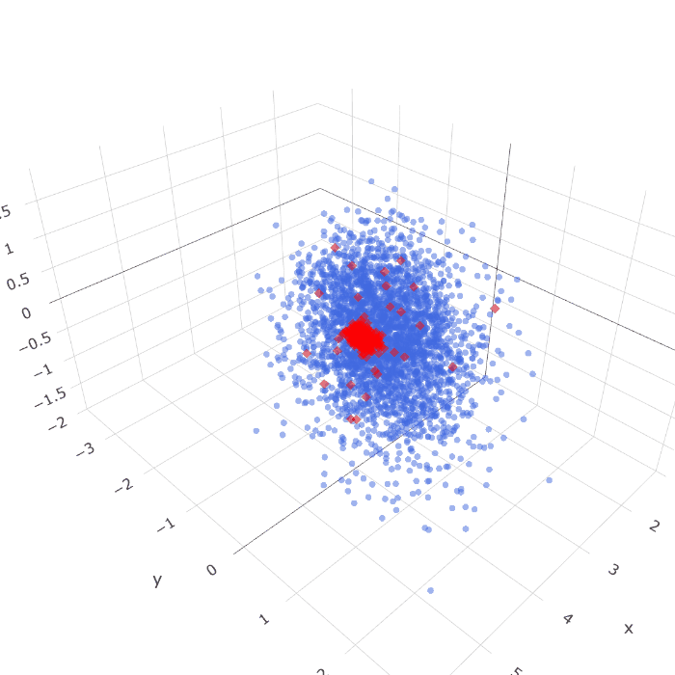
Simulated data -(3300 samples, 3000 Good, 300 Bad)
Dataset 1 |  | Dataset 2 |  | Dataset 3
Notes:
在案例分析的第一個小節中，我們將對模擬出的三種連續資料集做討論。
為了使生成資料具備分類價值與背景知識，本研究透過模擬三維座標點分布的方式，生成了兩種類別的浮點數座標
資料點具有X、Y、Z三維座標資訊，且區分為三百個紅色的少數類別、與三千個藍色的多數類別；兩種類別各自服從自身的資料分布，
且在多數的藍色類別中，可見到有少量的紅色類別躁點存在，目的在於增加分類任務的複雜度。
其中資料集一二兩種類別較為混雜；而資料集三中類別間則較為分散，表示其較為容易分類

Slide 43
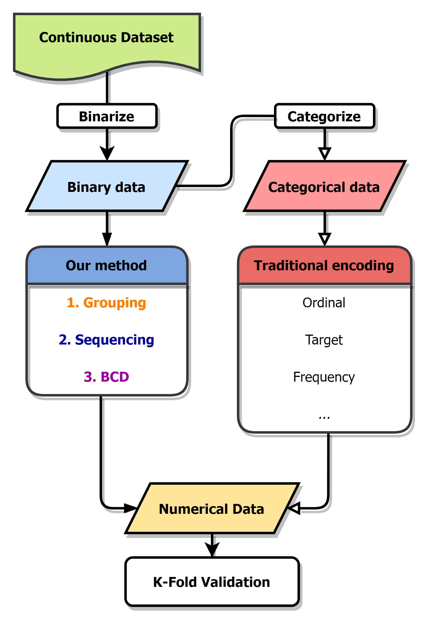
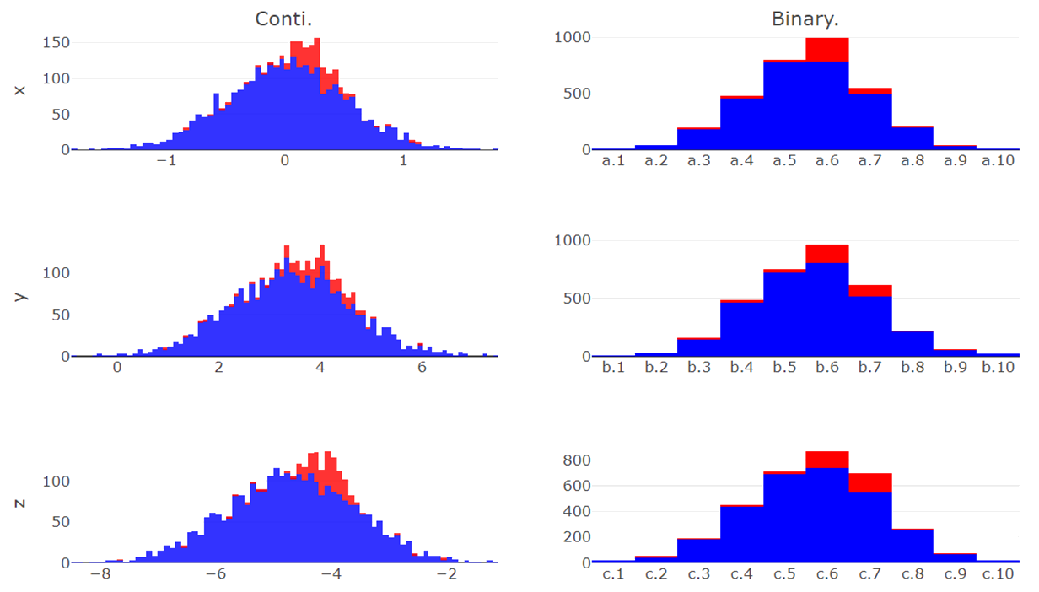
z.1 | z.2 | z.3 | z.4 | z.5 | z.6 | z.7 | z.8 | z.9 | z.10
y.1 | y.2 | y.3 | y.4 | y.5 | y.6 | y.7 | y.8 | y.9 | y.10
x.1 | x.2 | x.3 | x.4 | x.5 | x.6 | x.7 | x.8 | x.9 | x.10
Simulated data - binarize
Continuous Data | Binarize Data
counts
counts
X
counts
counts
Y
counts
counts
Z
Notes:
左圖為整體實驗流程，先透過連續資料產生二元資料，再將二元資料轉換為類別資料，並根據不同的編碼產生數值資料，最後由k-fold validations進行分類成果的比較
此分佈圖表示了原始連續資料於三個座標軸上的資料分布情形，且少數與多數類別由顏色區分；
而後根據欲劃分出的二元特徵個數，對此三個連續座標軸進行二元化處理

Slide 44
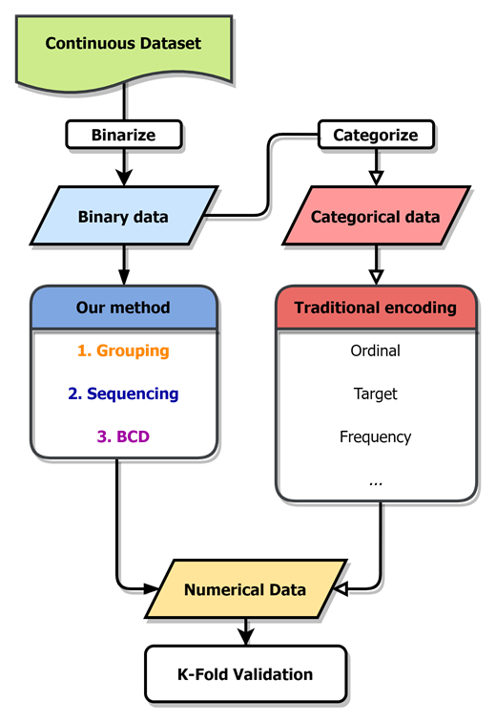
z.1 | z.2 | z.3 | z.4 | z.5 | z.6 | z.7 | z.8 | z.9 | z.10
y.1 | y.2 | y.3 | y.4 | y.5 | y.6 | y.7 | y.8 | y.9 | y.10
x.1 | x.2 | x.3 | x.4 | x.5 | x.6 | x.7 | x.8 | x.9 | x.10
Simulated data - binarize
Continuous Data | Binarize Data
counts
counts
X
counts
counts
Y
counts
counts
Z
Notes:
假設與從中劃分出30個二元特徵，便依據比例切分各個座標軸的全距
並將資料點劃分入新產生的二元特徵之中，如此，便產生了具備分類知識的二元特徵資料

Slide 45
z.1 | z.2 | z.3 | z.4 | z.5 | z.6 | z.7 | z.8 | z.9 | z.10
y.1 | y.2 | y.3 | y.4 | y.5 | y.6 | y.7 | y.8 | y.9 | y.10
x.1 | x.2 | x.3 | x.4 | x.5 | x.6 | x.7 | x.8 | x.9 | x.10
Simulated data - Categorize
Categorical Data | Binarize Data
Instances | X | Y | Z
1 | x.2 | y.9 | z.4
2 | x.1 | y.8 | z.2
3 | x.9 | y.1 | z.6
4 | x.5 | y.7 | z.8
5 | x.3 | y.1 | z.8
6 | x.5 | y.6 | z.3
7 | x.7 | y.5 | z.4
⁝ | ⁝ | ⁝ | ⁝
3300 | x.4 | y.8 | z.1
Instances | x.1 | x.2 | x.3 | x.4 | x.5 | x.6 | … | z.9 | z.10
1 | 0 | 1 | 0 | 0 | 0 | 0 | … | 0 | 0
2 | 1 | 0 | 0 | 0 | 0 | 0 | … | 0 | 0
3 | 0 | 0 | 0 | 0 | 0 | 0 | … | 0 | 0
4 | 0 | 0 | 0 | 0 | 1 | 0 | … | 0 | 0
5 | 0 | 0 | 1 | 0 | 0 | 0 | … | 0 | 0
6 | 0 | 0 | 0 | 0 | 1 | 0 | … | 0 | 0
7 | 0 | 0 | 0 | 0 | 0 | 0 | … | 0 | 0
⁝ | ⁝ | ⁝ | ⁝ | ⁝ | ⁝ | ⁝ | ⁝ | ⁝ | ⁝
3300 | 0 | 0 | 0 | 1 | 0 | 0 | … | 0 | 0
Notes:
而以表格方式呈現方才二元化的連續座標軸
可見原先的連續資料現以被劃分成為30個二元特徵

Slide 46
Simulated data - Categorize
Categorical Data | Binarize Data
Instances | X | Y | Z
1 | x.2 | y.9 | z.4
2 | x.1 | y.8 | z.2
3 | x.9 | y.1 | z.6
4 | x.5 | y.7 | z.8
5 | x.3 | y.1 | z.8
6 | x.5 | y.6 | z.3
7 | x.7 | y.5 | z.4
⁝ | ⁝ | ⁝ | ⁝
3300 | x.4 | y.8 | z.1
Instances | x.1 | x.2 | x.3 | x.4 | x.5 | x.6 | … | z.9 | z.10
1 | 0 | 1 | 0 | 0 | 0 | 0 | … | 0 | 0
2 | 1 | 0 | 0 | 0 | 0 | 0 | … | 0 | 0
3 | 0 | 0 | 0 | 0 | 0 | 0 | … | 0 | 0
4 | 0 | 0 | 0 | 0 | 1 | 0 | … | 0 | 0
5 | 0 | 0 | 1 | 0 | 0 | 0 | … | 0 | 0
6 | 0 | 0 | 0 | 0 | 1 | 0 | … | 0 | 0
7 | 0 | 0 | 0 | 0 | 0 | 0 | … | 0 | 0
⁝ | ⁝ | ⁝ | ⁝ | ⁝ | ⁝ | ⁝ | ⁝ | ⁝ | ⁝
3300 | 0 | 0 | 0 | 1 | 0 | 0 | … | 0 | 0
Notes:
而根據此30個二元特徵與其群組資訊得以轉化出資料的類別變數型態
此兩種資料乃為一體兩面，僅僅在呈現方式上有所差異，但其本質代表的資料質實無異
類似於原始類別資料，之於獨熱編碼轉換出的二元資料。
如此，便得以為本研究方法，與傳統變數編碼方法，設定出相同的起跑線
而後進行分類成果的比較

Slide 47
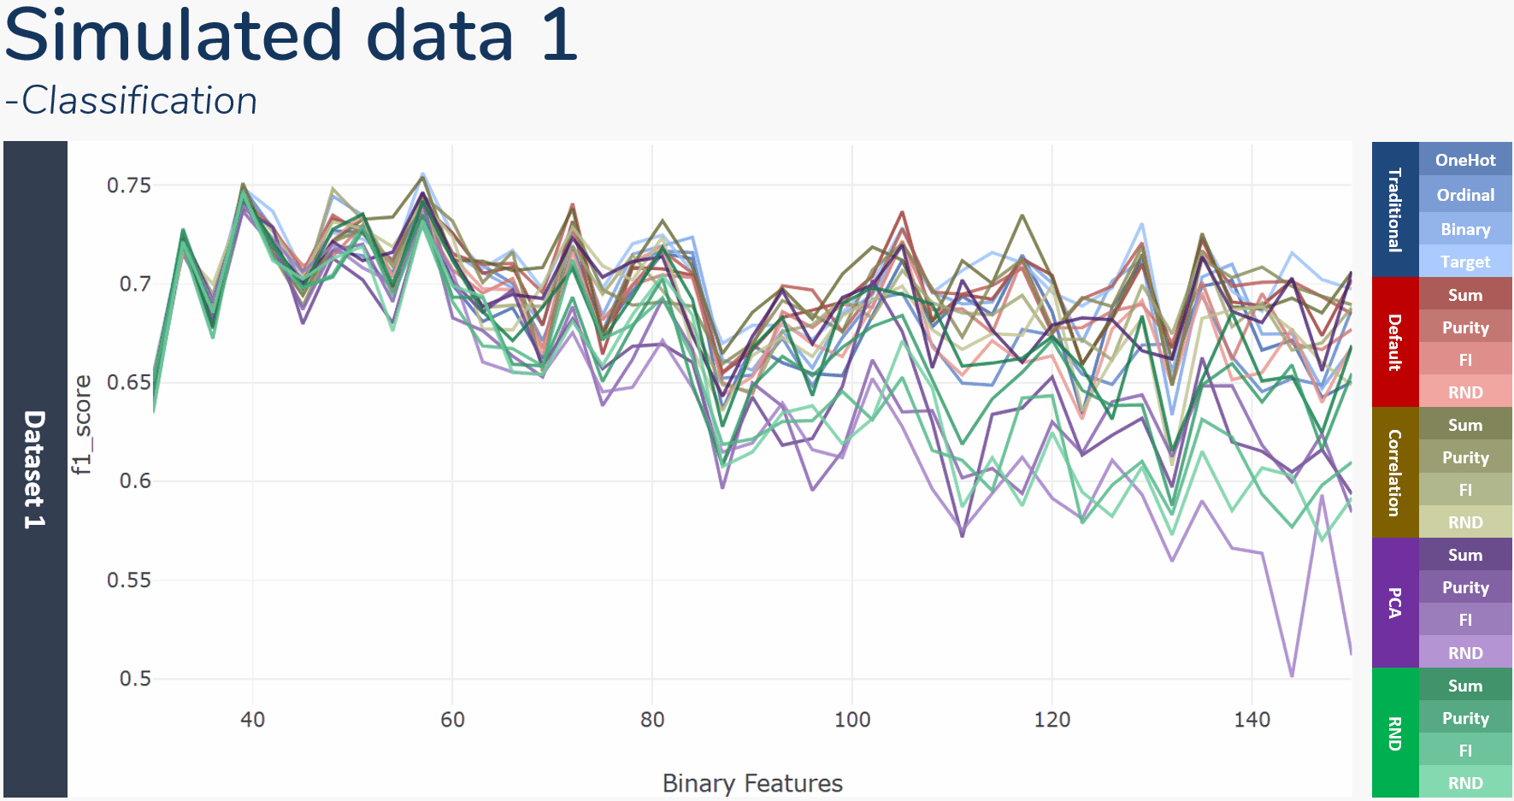
Notes:
在分類結果的評比中，將與OneHot, Binary, Ordinal, 與Target encoding等4種傳統的變數編碼比較
以及本研究四種群組方式，分別是根據原先群組資訊、主成分分析、皮爾森相關係數與隨機群組
結合4種排序方式，分別是特徵總和、類別純粹度、特徵重要性、與隨機排列
並以LightGBM梯度提升決策樹作為分類模型，且f1 score作為數值資料衡量標準
此折線圖則顯示了在切分出不同的二元特徵之下，各種方法k-folds驗證後的平均f1 score變化
觀察了此三張折線圖可見，在切分的二元變數數量較少時，所有變數編碼產生的數值資料有著相近的分類成績；
然而，隨著所切分的二元變數個數增加，變數編碼產生數值資料的分類成績之間的變異也逐漸增加、
且分類成績也有著緩步下降的趨勢，類似在維度災難發生時導致的模型成果下降。

Slide 48
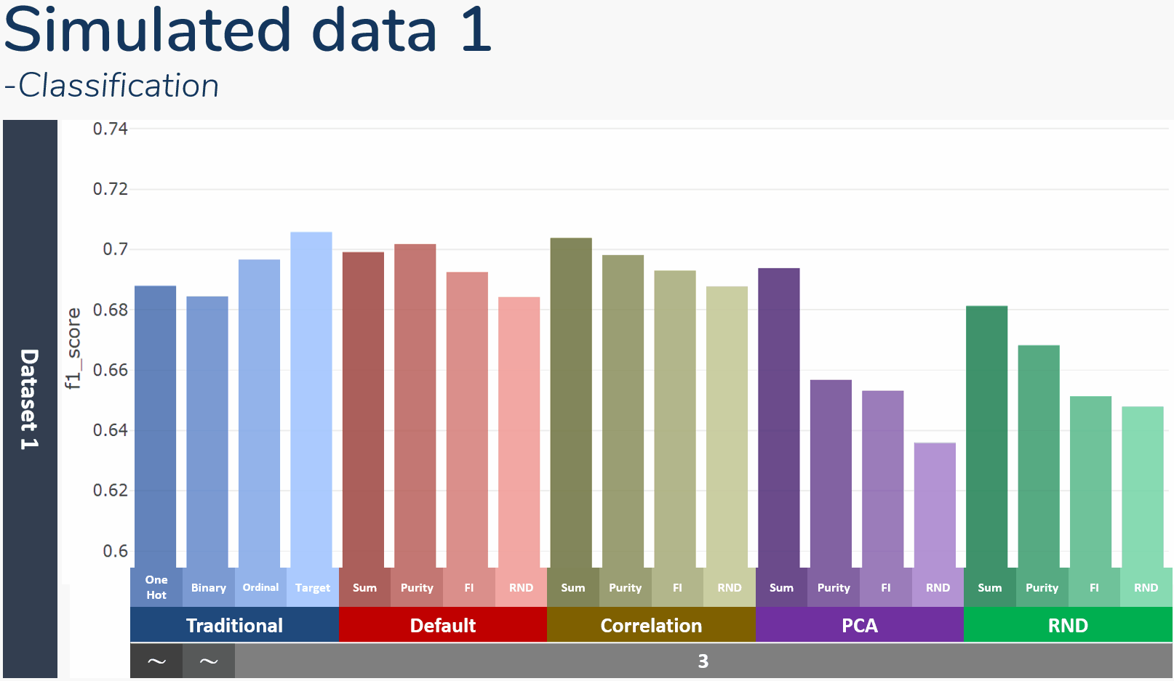
Simulated data 1 -Classification
Notes:
此直方圖則顯示了方才折線圖的平均成績，底下黑灰色欄位中則表示了該方法產生新數值資料的特徵個數
可以發現OneHot, Binary encoding的特徵各數是不固定的，OneHot 資料即為切分出的整體二元特徵
而Binary encoding使用特徵數將少於全數二元特徵個數
其中值得注意的以隨機排序的方式，其皆產出群組中最低的分類成績，表示排序對於編碼後數值資料的分類成果具有一定影響
以及由不同群組方式產生的數值資料有著不盡相同的平均成績，不論根據何種方式排序組內特徵，分類成績仍部分受到群組方式的影響
由於屬於監督式的變數編碼，目標編碼的表現相當出眾，在傳統編碼中能持續獲得最好的成績

Slide 49
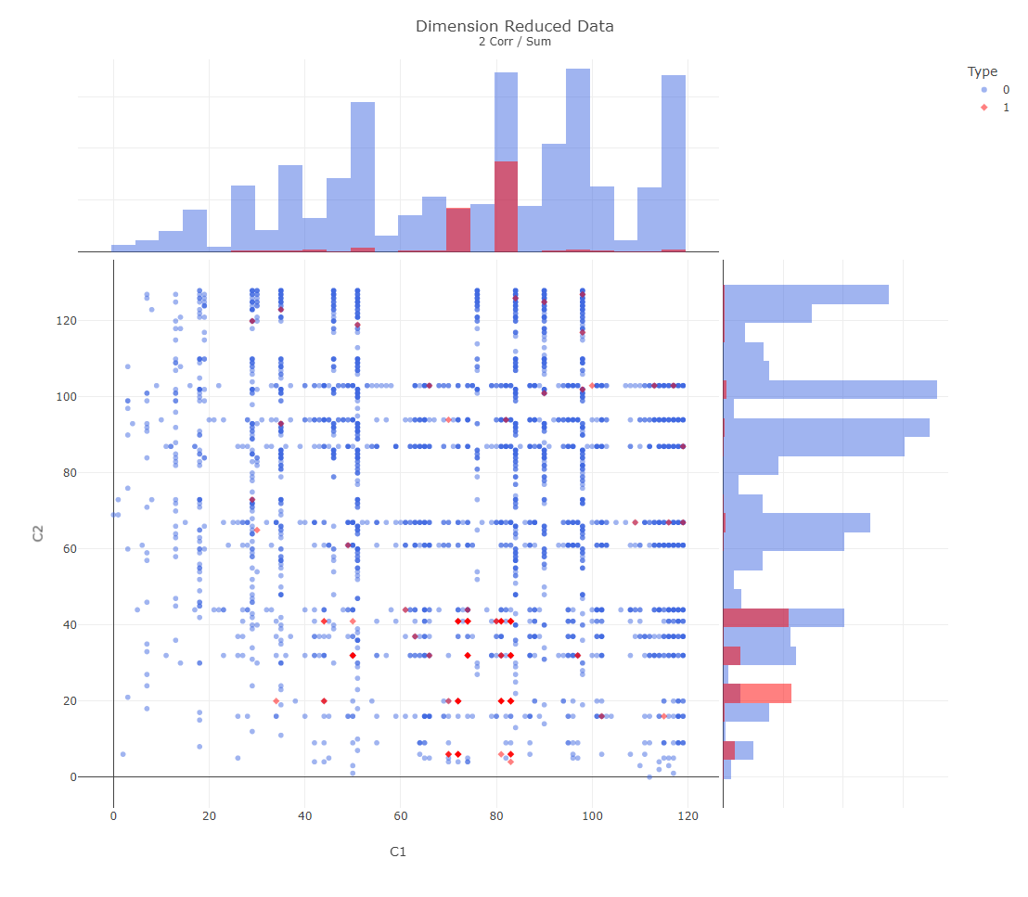
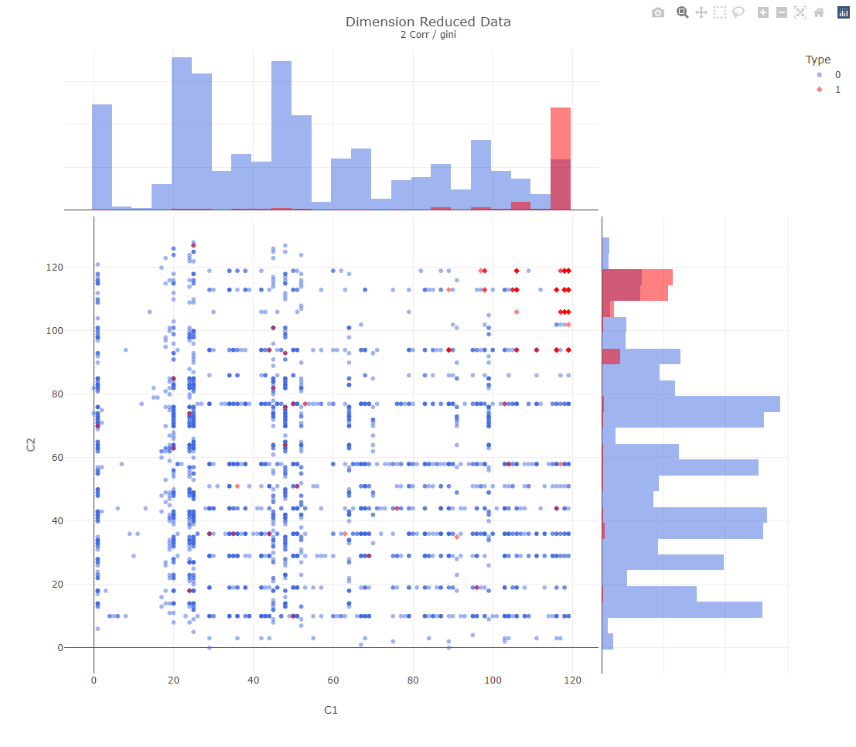
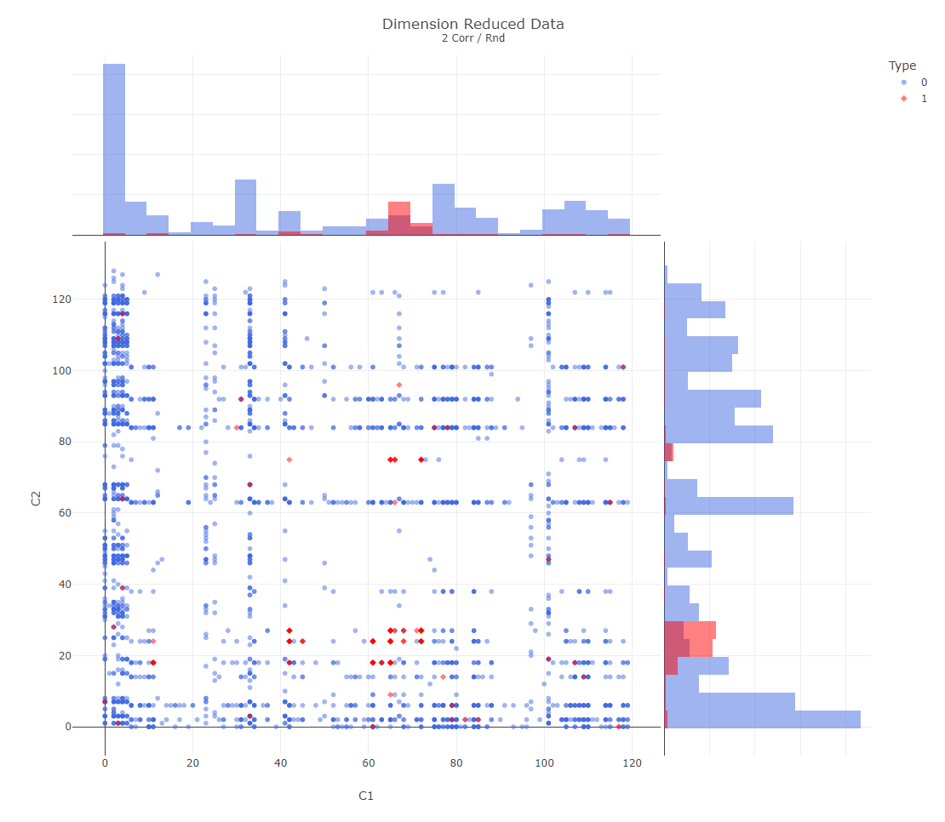
Simulated data -Dimension reduction
Sum | Impurity | RND
Notes:
本研究發展的二元變數編碼方式也可以做為二元資料的降維方法來使用。只需選定群組與排序方式，
便能將高維度的二元資料，轉變成僅具有群組個數維度的數值資料
若將群組個數設定成二維或是三維，即可將原先多維度的二元資料投影至可視覺化的維度進行分析，
亦可同時比較不同排序與群組方式的有效度。
如此三張圖，便是連續資料集三，在150個二元變數切分之下，經由相關係數群組，在經由不同排序後產生的二維資料分佈
可以明顯看出以純粹度排序的資料更能產生適合分類的數值資料，投影了兩種類別資料至數線的兩端，得以讓編碼後的數值資料更易以類別區分

Slide 50
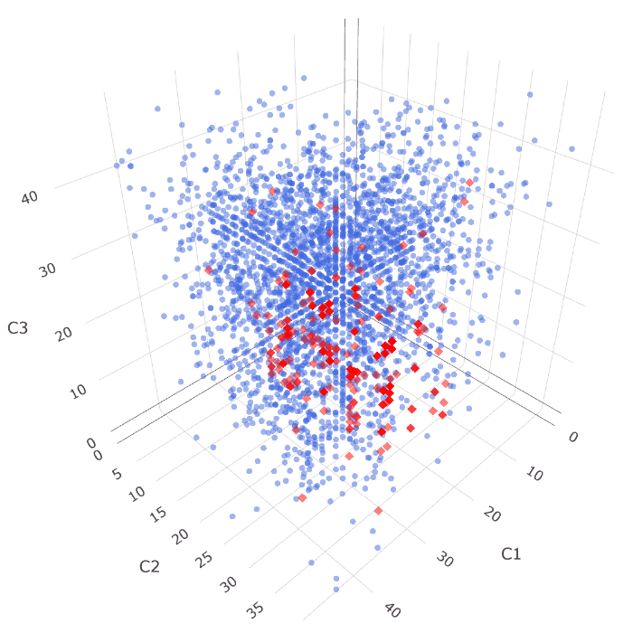
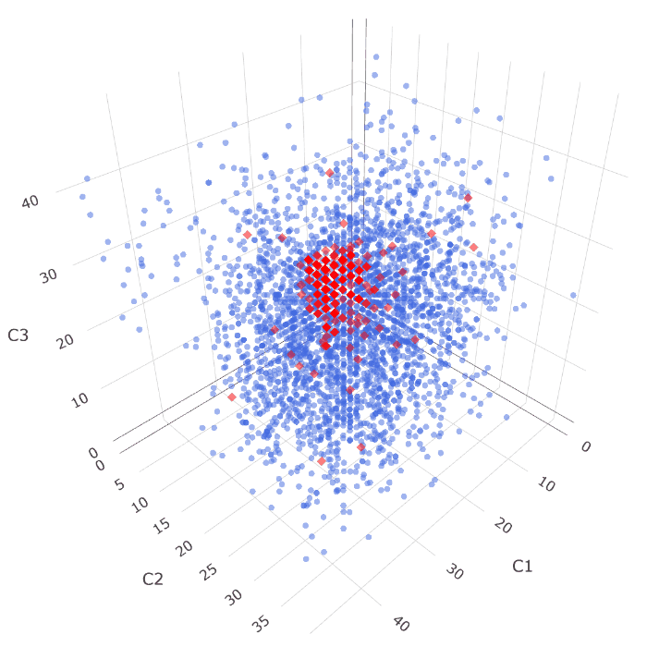
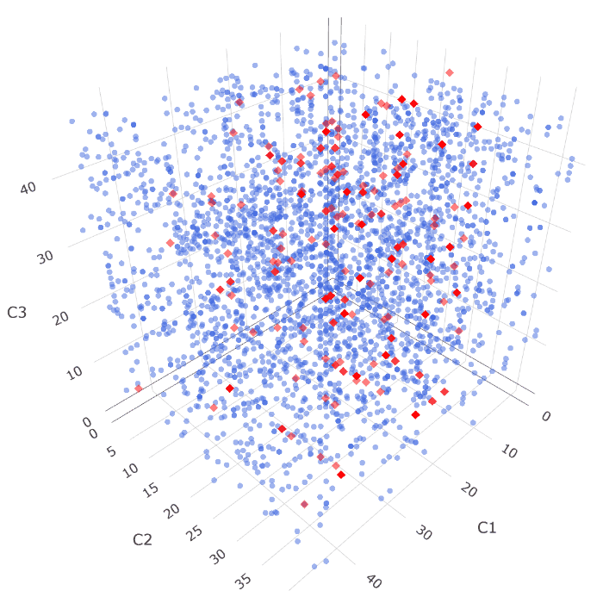
Simulated data -Dimension reduction
Sum | Impurity | RND
Notes:
也能將編碼後的資料做立體投影，更可以明顯感受出排序方法之間的差異程度
像是以隨機排列，兩類資料則與彼此相混雜，無法找出適合的切分點來區隔特徵
導致模型無法有效找出切分資料，使分類成果大受影響

Slide 51
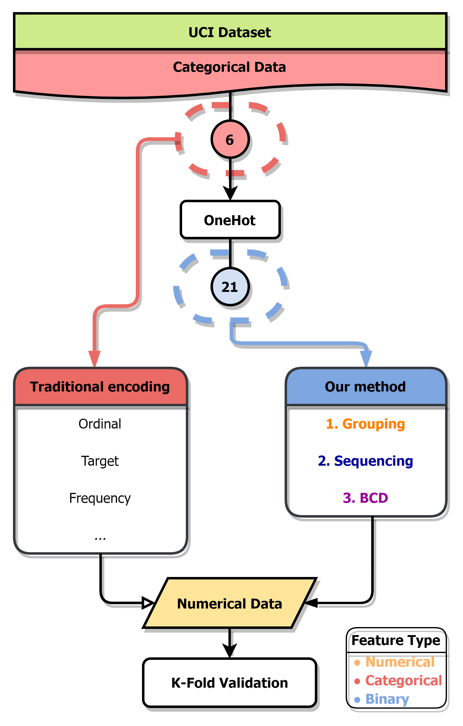
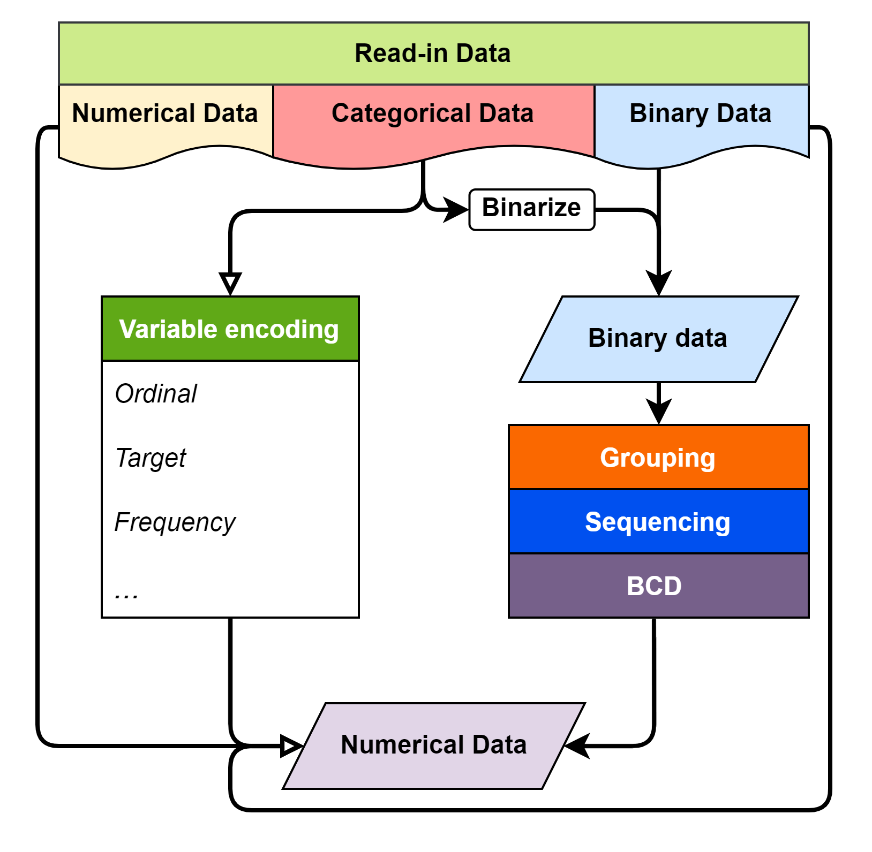
UCI dataset
Feature uniqueness of UCI car evaluation dataset
Price | Maintenance | Doors | Persons | Luggage boot | Safety | Evaluation
vhigh | vhigh | 2 | 2 | small | med | Acceptable
high | high | 3 | 4 | med | high | Unacceptable
med | med | 4 | more | big | low
low | low | 5more
Notes:
因應參考文獻中所涉及的變數編碼比較相關研究，於UCI線上資料及網站之中採用與其相同的標竿資料集，
此車輛評估資料集較為簡單，僅僅具有六個類別變數作為輸入，來預測車輛為可接受、或是不可接受的狀態

Slide 52
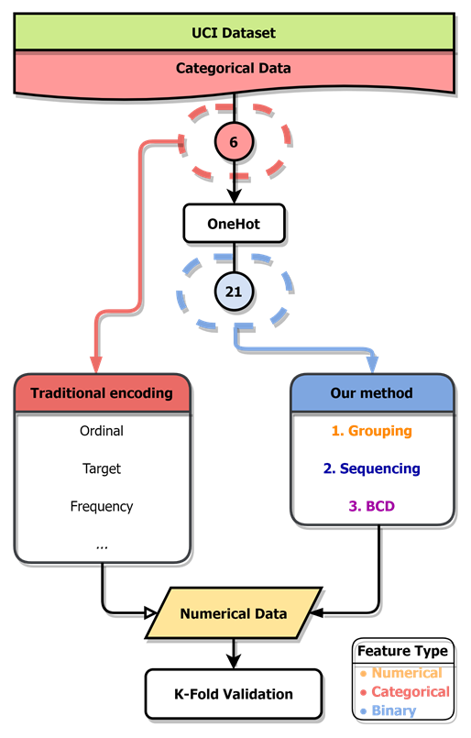
UCI dataset
Feature uniqueness of UCI car evaluation dataset
Price | Maintenance | Doors | Persons | Luggage boot | Safety | Evaluation
vhigh | vhigh | 2 | 2 | small | med | Acceptable
high | high | 3 | 4 | med | high | Unacceptable
med | med | 4 | more | big | low
low | low | 5more
Notes:
此6個類別變數經由OneHot encoding轉換之後，將產生21個二元變數，
以作為本研究方法輸入，並與傳統變數編碼相比較

Slide 53
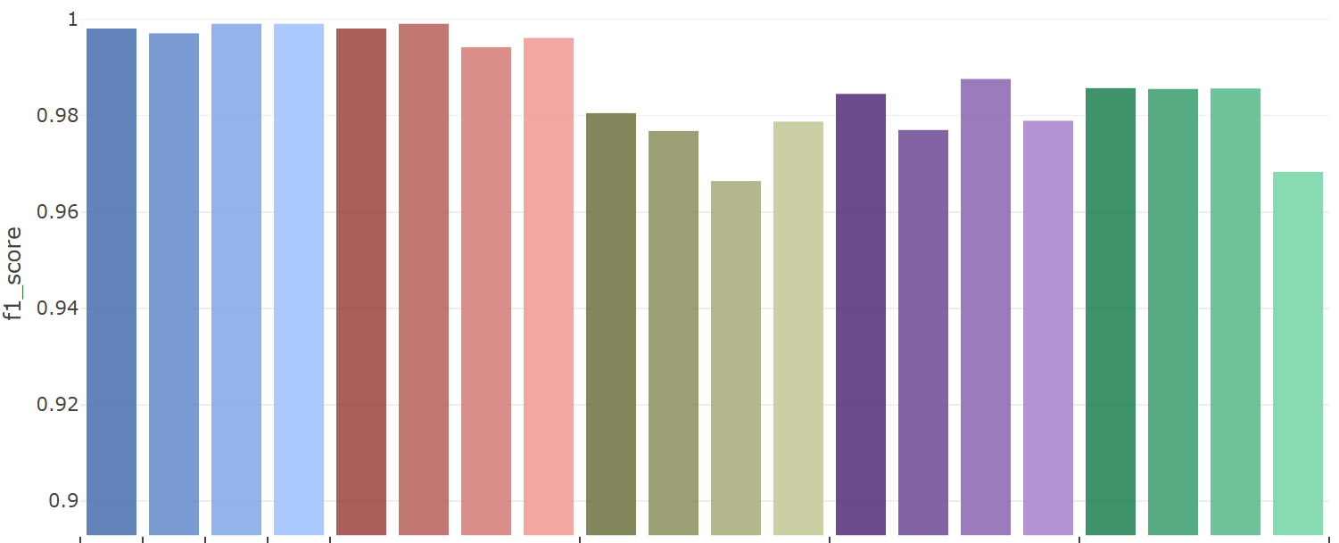
UCI dataset -Classification
Car Evaluations Dataset
 | One Hot | Binary | Ordinal | Target | Sum | Purity | FI | RND | Sum | Purity | FI | RND | Sum | Purity | FI | RND | Sum | Purity | FI | RND
 | Traditional |  |  |  | Default |  |  |  | Correlation |  |  |  | PCA |  |  |  | RND
 | 21 | 15 | 6
Notes:
可以看見傳統變數編碼方式、以及依照原先群組資訊而產生的數值資料集皆表現得相當優異，
甚至是單純的二元特徵資料即表現的相當不錯；反之，透過相關係數、主成分分析或隨機群組的方式皆造成分類成績的損失。
本研究推論此結果的原因有二：其一是此資料本身過於單純，且LightGBM在二十一個二元特徵之下仍能表現出不錯的分類能力，
當遭遇維度較低的二元資料問題時，使用本研究所發展之二元特徵編碼方式將無法有效用的使新數值資料的分類成績有大幅度的提升
其二則是群組方式仍需改進，根據相關係數、主成分分析的群組方式，皆無法達到根據原先的二元資料群組資訊相同的組分類平均，
而且也無法明顯的比隨機群組方式來的優越。

Slide 54
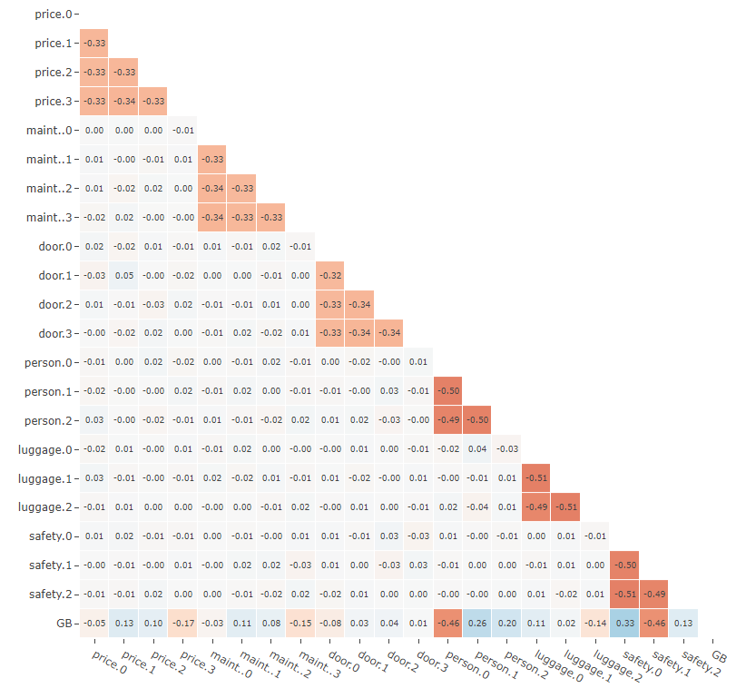
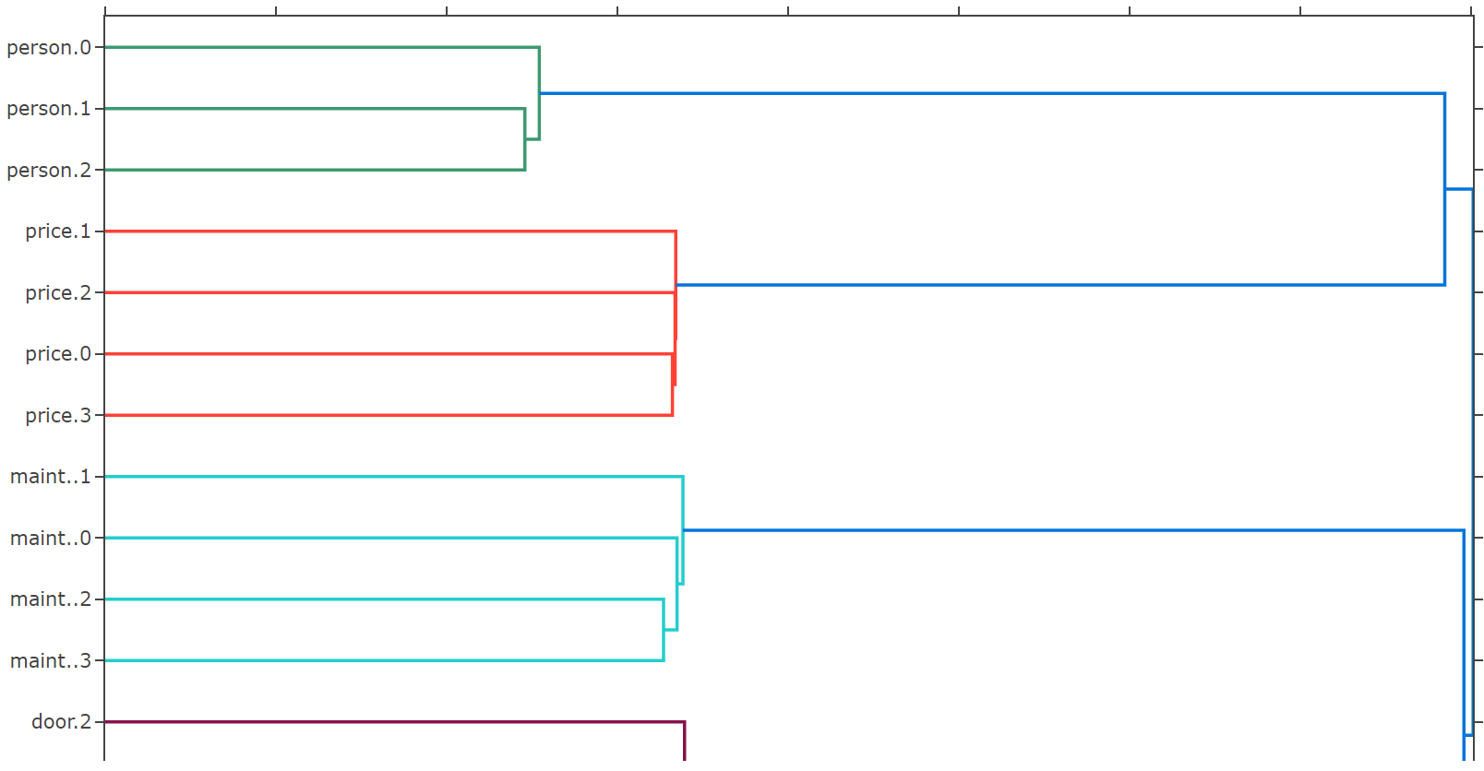
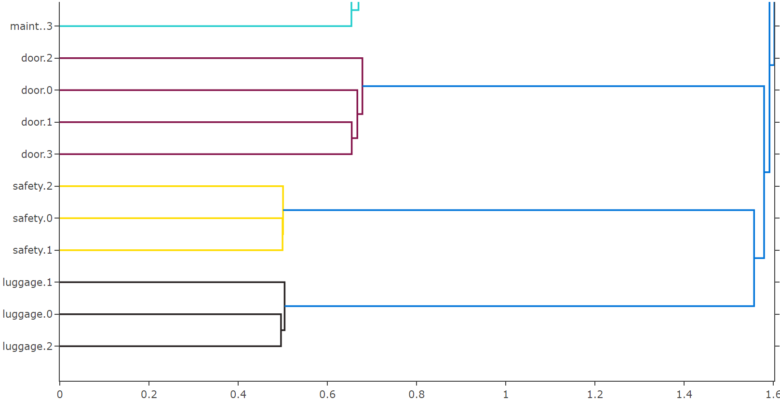
UCI dataset -Group by hierarchical clustering
Notes:
此處則改以階層聚類結合相關係數進行特徵群組，根據特徵之間的相關性，
找出獨熱編碼後產生的二元特徵之間互斥關係，並還原出原始的群組資訊。
此方法群組結果將與根據原始群組資訊群組有著完全相同輸出
可將其作為一種還原二元資料特徵群組資訊的方式
但作為本研究所預想的群組方式乃是著重在於藉由結合、群聚由不同類別特徵所產生的二元特徵，
以融合出更具有分類價值與資料特性的新數值特徵，
而此方法與依據原始群組資訊所產生特徵群組完全相同，
因此並未加入群組方法中與其餘方式做比較。

Slide 55

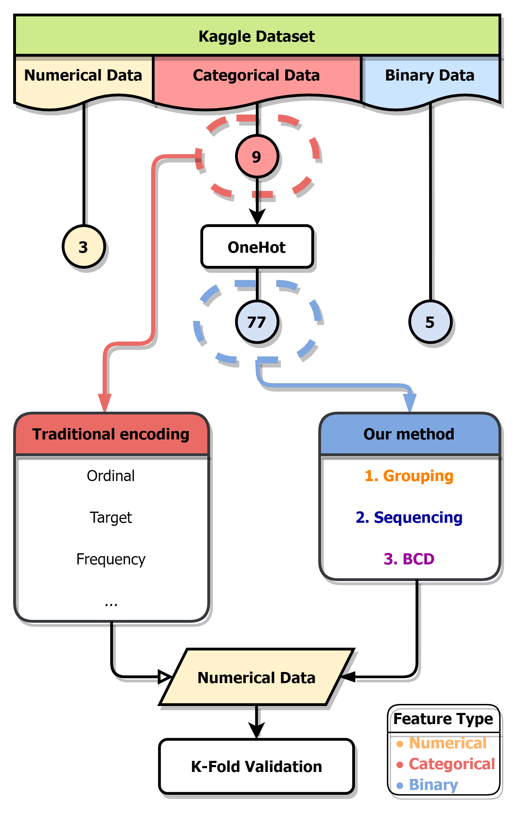
Kaggle dataset
Numerical feature uniqueness of Kaggle CFEC dataset
bin0 | bin1 | bin2 | bin3 | bin4 | ord0 | day | month | Target
0 | 0 | 0 | 0 | 0 | 1 | 1 | 1 | 0
1 | 1 | 1 | 1 | 1 | 2 | 2 | 2 | 1
 |  |  |  |  | 3 | 3 | 3
 |  |  |  |  |  | ⁝ | ⁝
 |  |  |  |  |  | 7 | 12
Categorical feature uniqueness of Kaggle CFEC dataset
nom0 | nom1 | nom2 | nom3 | nom4 | ord1 | ord2 | ord3 | ord4
Green | Triangle | Snake | Finland | Bassoon | Grandmaster | Cold | a | A
Blue | Trapezoid | Hamster | Russia | Piano | Expert | Hot | b | B
Red | Polygon | Lion | Canada | Theremin | Novice | Lava Hot | c | C
 | Square | Cat | Costa Rica | Oboe | Contributor | Boiling Hot | d | D
 | Star | Dog | China |  | Master | Freezing | ⁝ | ⁝
 | Circle | Axolotl | India |  |  | Warm | o | Z
Notes:
經由先前的試驗後，本研究亦嘗試應用於更加複雜的資料集當中，
便於Kaggle網站上找到了類別特徵編碼挑戰資料集，該資料集同時具有數值、類別與二元變數
且同為二元分類問題；經由獨熱編碼後將產生眾多二元特徵，符合本研究對於高維度二元資料的要求。

Slide 56
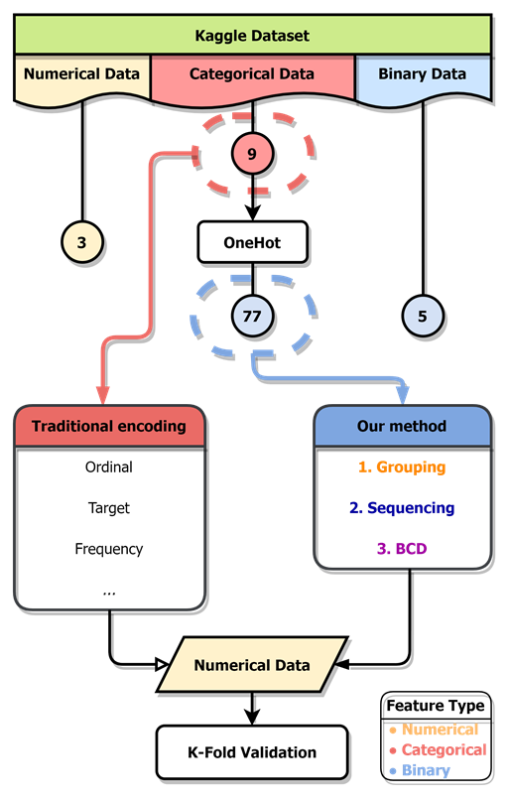
Kaggle dataset
Numerical feature uniqueness of Kaggle CFEC dataset
bin0 | bin1 | bin2 | bin3 | bin4 | ord0 | day | month | Target
0 | 0 | 0 | 0 | 0 | 1 | 1 | 1 | 0
1 | 1 | 1 | 1 | 1 | 2 | 2 | 2 | 1
 |  |  |  |  | 3 | 3 | 3
 |  |  |  |  |  | ⁝ | ⁝
 |  |  |  |  |  | 7 | 12
Categorical feature uniqueness of Kaggle CFEC dataset
nom0 | nom1 | nom2 | nom3 | nom4 | ord1 | ord2 | ord3 | ord4
Green | Triangle | Snake | Finland | Bassoon | Grandmaster | Cold | a | A
Blue | Trapezoid | Hamster | Russia | Piano | Expert | Hot | b | B
Red | Polygon | Lion | Canada | Theremin | Novice | Lava Hot | c | C
 | Square | Cat | Costa Rica | Oboe | Contributor | Boiling Hot | d | D
 | Star | Dog | China |  | Master | Freezing | ⁝ | ⁝
 | Circle | Axolotl | India |  |  | Warm | o | Z
Notes:
在篩除部分特徵、與前處理後，此資料集當中可見有5個二元特徵、3個數值特徵以及9個類別特徵
oneHot encoding後，將產生77個二元特徵；且原始資料中的二元、數值特徵也會併入新編碼後的資料當中

Slide 57
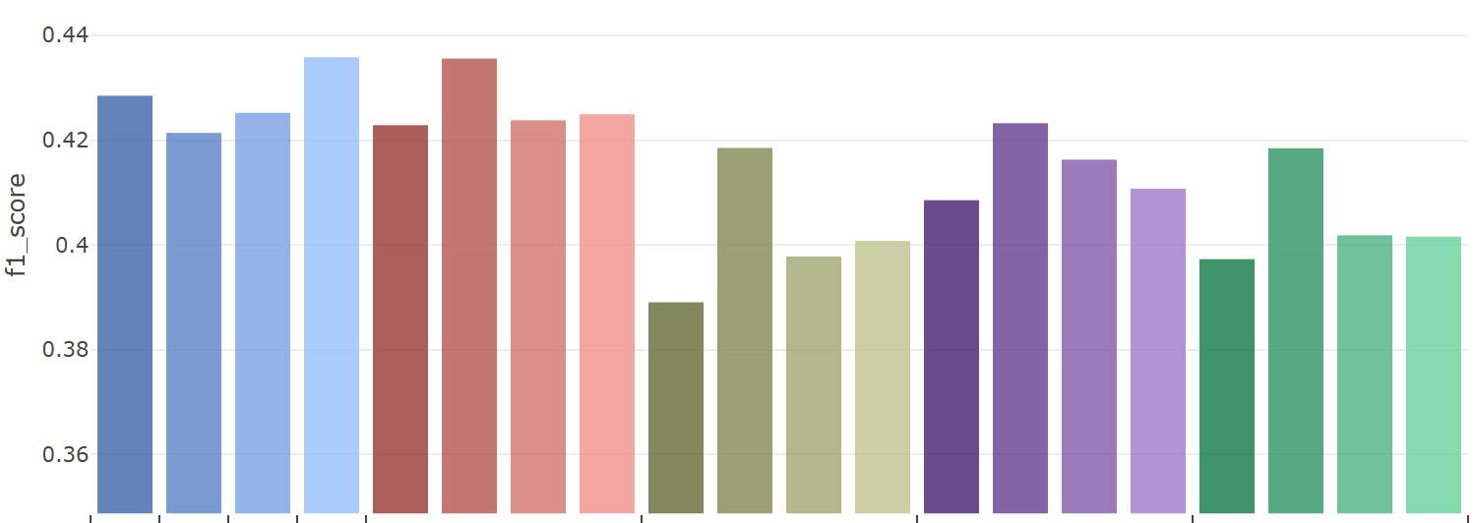
Kaggle dataset -Classification
Feature Encode Challenge
 | One Hot | Binary | Ordinal | Target | Sum | Purity | FI | RND | Sum | Purity | FI | RND | Sum | Purity | FI | RND | Sum | Purity | FI | RND
 | Traditional |  |  |  | Default |  |  |  | Correlation |  |  |  | PCA |  |  |  | RND
 | 85 | 37 | 17
Notes:
可以明顯發現分群、與排序對於編碼後資料集的明顯影響、以及本研究方法與傳統編碼方式之間的差異。
像是在傳統的變數編碼中，相較於其餘非監督式的編碼方式，監督式的目標編碼對於產生之數值資料的分類成績有明顯提升。
而不同的群組方式也會影響分類成績，依照原先群組資訊群組特徵將有著更高的平均分類成績，
再來則分別是以主成分分析、相關係數及隨機群組的方式。在各個群組方式中、不同排序方法之下，
可以發現以特徵純粹度排序將產生出分類成績較佳的數值資料。

Slide 58
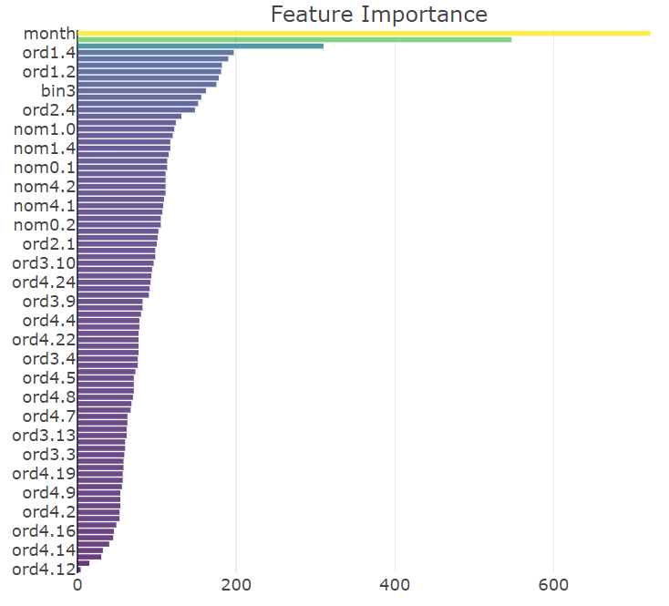
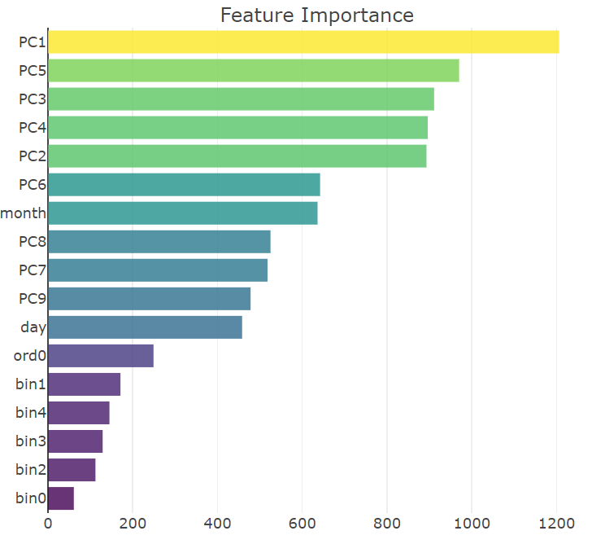
Kaggle dataset -Feature importance changes
One Hot | PCA
Notes:
由 LightGBM訓練出的梯度提升樹分類模型中的各特徵重要性可以發現，相較於編碼前的二元資料，
編碼後的數值資料的平均特徵重要度有著顯著提升，代表原先難以區分目標類別的二元特徵經由壓縮與融合，
成為了更具有分類價值的數值特徵。

Slide 59
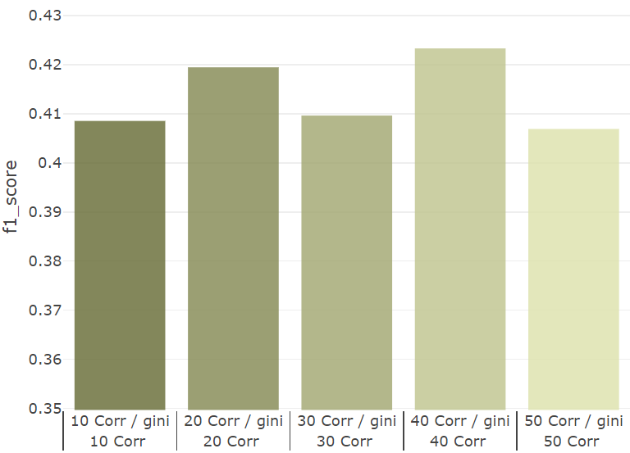
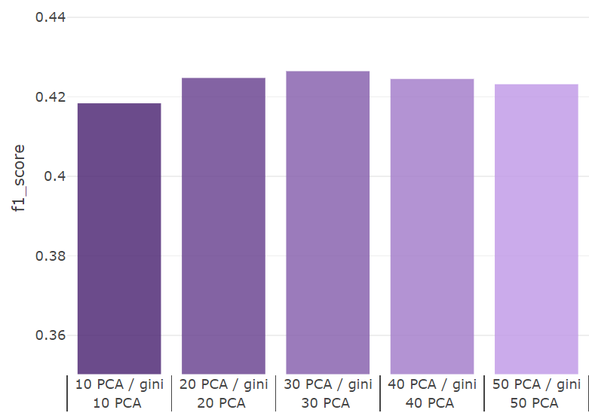
Kaggle dataset -Different grouping seizes
Correlation | PCA
 | Purity | Purity | Purity | Purity | Purity
 | Correlation
 | 10 | 20 | 30 | 40 | 50
 | Purity | Purity | Purity | Purity | Purity
 | PCA
 | 10 | 20 | 30 | 40 | 50
Notes:
此處則是在以不同的特徵組個數，嘗試將二元資料
可以發覺，分類成績隨著群組個數增加後而緩慢減少，有著類似於維度災難發生之前的成績提升。

Slide 60
Conclusion
In this research, we develop a method to encode binary feature data into numerical data, which can compress the binary features information to reduce dimension while remaining a certain level in ML model classification performance. The main advantage of this method compare to traditional encoding methods are:
Able to encoding binary features without group knowledge to numerical data.
Adjust the number of features of encoded numerical data unconstrainedly.
Preserve ML model performance with certain sequencing method.
As a dimension reduction method of high dimensional binary data.
Notes:
相較於傳統變數編碼僅針對類別型態的資料，本研究提出了一種將二元特徵資料編碼成數值資料的架構設計
，透過群組、排序與二進位十位數編碼等一連串步驟，不論原先的二元特徵資料是否包含二元特徵群組的資訊，皆可以將其編碼成數值資料的形式。
藉由二元特徵群組，得以縮減、壓縮高維度二元資料維度資訊至較低維度；而後由特徵組內的排序，得以提升編碼後數值資料集的分類成績；
最終，藉由二進位十位數編碼，將同一群組內的複數二元特徵轉換成為單一整數數值特徵。

Slide 61
Future work
Sadly, there is still lacking a better grouping method that doesn’t follow the default feature Grouping information. Also, maybe the Sequencing can be model as the optimization problem, and solved with optimization models:
New methods in Grouping & Sequencing.
How to find optimal dimension of the data?
Solving Sequencing as an optimization problem.
Notes:
在未來研究方向的部分，可以嘗試擴充現有的群組、排序方式
以找尋出不與原先群組資訊相同、但對於分類任務具有優勢的群組方式
或是嘗試將排序問題透過最佳化模型求解等
皆可做為本研究未來的研究目標

Slide 62
Methodology -Sequencing
Group
Sequence
BCD
Grouped by PCA | Sequenced by column sum
Notes:
此為依據PCA群組，再以特徵總合重新排序組內特徵的成果

Slide 63
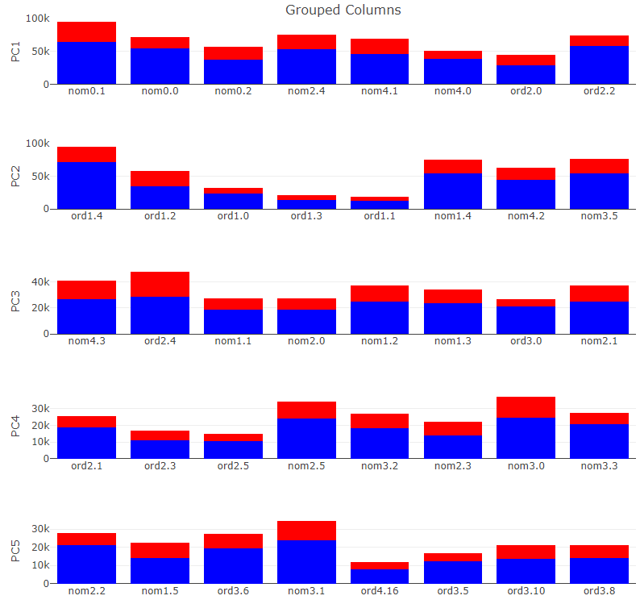
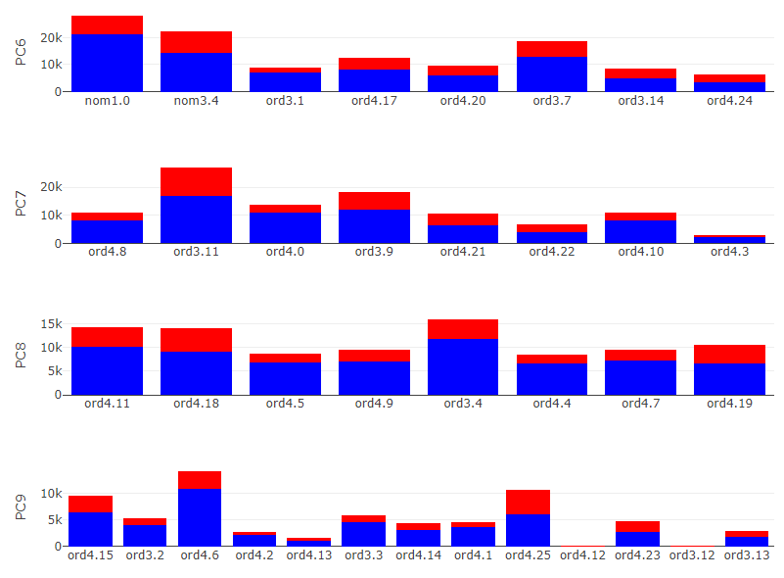
Kaggle dataset -Feature importance changes

Slide 64
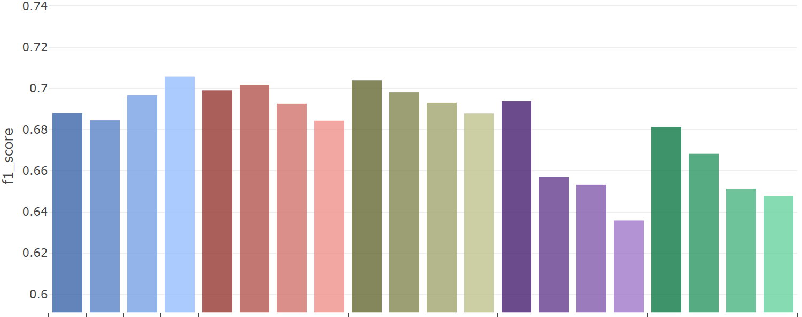
Simulated data 1 -Classification
Dataset 1
 | One Hot | Binary | Ordinal | Target | Sum | Purity | FI | RND | Sum | Purity | FI | RND | Sum | Purity | FI | RND | Sum | Purity | FI | RND
 | Traditional |  |  |  | Default |  |  |  | Correlation |  |  |  | PCA |  |  |  | RND
 | ～ | ～ | 3
Notes:
此直方圖則顯示了方才折線圖的平均成績，底下黑灰色欄位中則表示了該方法產生新數值資料的特徵個數
可以發現OneHot, Binary encoding的特徵各數是不固定的，OneHot 資料即為切分出的整體二元特徵
而Binary encoding使用特徵數將少於全數二元特徵個數
其中值得注意的有RND排序方式，其皆產出群組中最低的分類成績
且Target encoding皆聚有不俗表現，因為其本身即屬於一種監度式的變數編碼方式

Slide 65
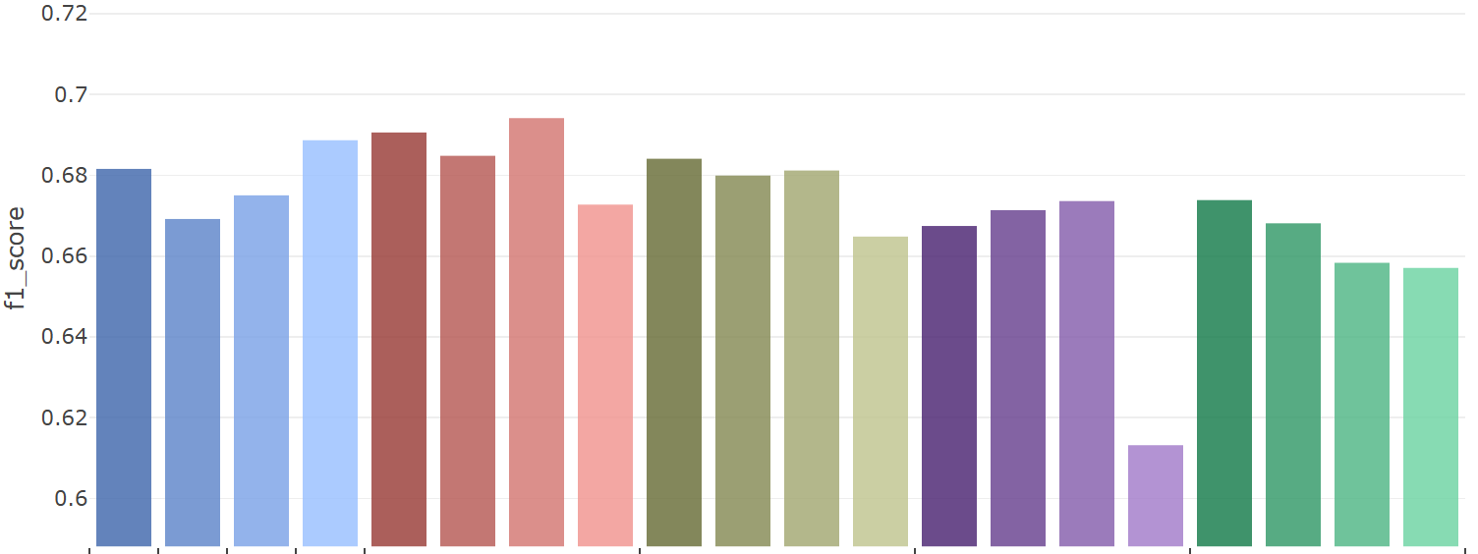
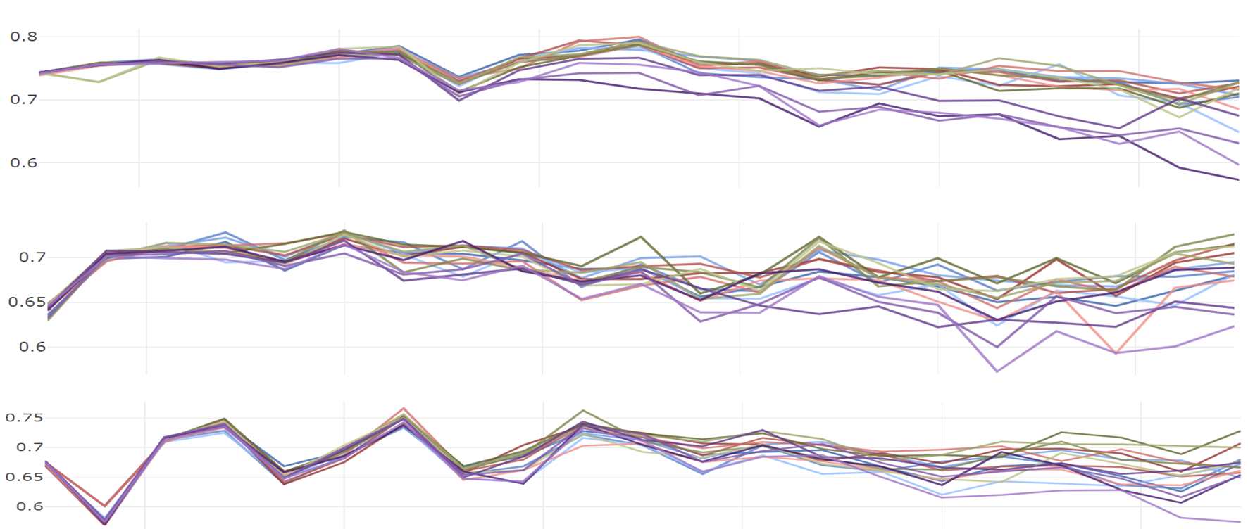
Simulated data 2 -Classification
Dataset 2
 | One Hot | Binary | Ordinal | Target | Sum | Purity | FI | RND | Sum | Purity | FI | RND | Sum | Purity | FI | RND | Sum | Purity | FI | RND
 | Traditional |  |  |  | Default |  |  |  | Correlation |  |  |  | PCA |  |  |  | RND
 | ～ | ～ | 3
Notes:
此為連續資料集二中不同方法的成績平均，依然可見RND排序方法於各群組方式中墊底
且Target encoding皆聚有不俗表現，因為其本身即屬於一種監度式的變數編碼方式
所以其分類成績皆優於其餘的變數編碼方式

Slide 66
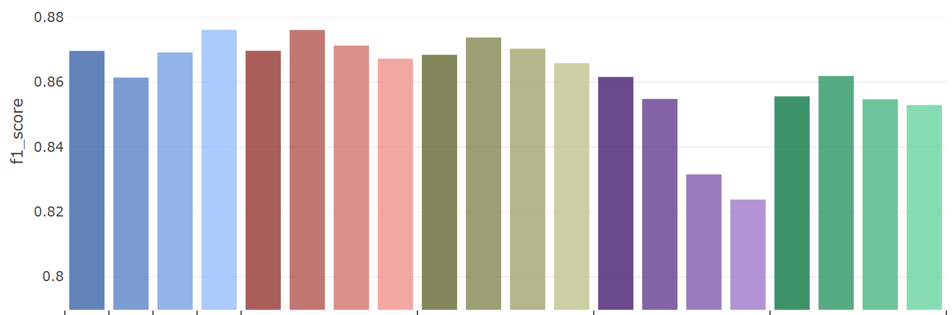
Simulated data 3 -Classification
Dataset 3
 | One Hot | Binary | Ordinal | Target | Sum | Purity | FI | RND | Sum | Purity | FI | RND | Sum | Purity | FI | RND | Sum | Purity | FI | RND
 | Traditional |  |  |  | Default |  |  |  | Correlation |  |  |  | PCA |  |  |  | RND
 | ～ | ～ | 3
Notes:
此為連續資料集三中不同方法的成績平均，
由原始連續圖形中可見，本資料集兩種類別區分容易，本身便易於區分
相較前兩個資料集有著較高的分類成績

Slide 67
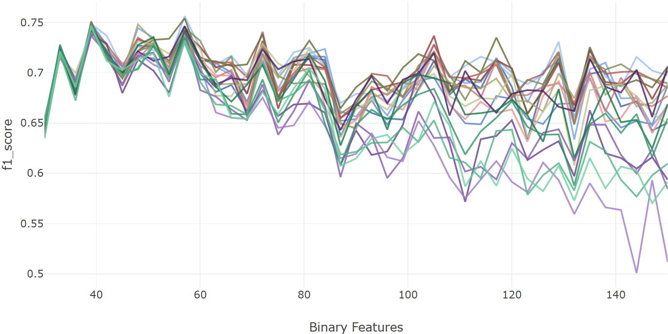
Simulated data 1 -Classification
Dataset 1
Traditional | OneHot
 | Ordinal
 | Binary
 | Target
Default | Sum
 | Purity
 | FI
 | RND
Correlation | Sum
 | Purity
 | FI
 | RND
PCA | Sum
 | Purity
 | FI
 | RND
RND | Sum
 | Purity
 | FI
 | RND
Notes:
在分類結果的評比中，與OneHot, Binary, Ordinal, 與Target encoding等4種傳統的變數編碼比較
以及本研究四種群組方式，分別是根據原先群組資訊、主成分分析、皮爾森相關係數與隨機群組
結合4種排序方式，分別是特徵總和、類別純粹度、特徵重要性、與隨機排列
並以LightGBM梯度提升決策樹作為分類模型，且f1 score作為數值資料衡量標準
此折線圖則顯示了在切分出不同的二元特徵之下，各種方法k-folds驗證後的平均f1 score變化

Slide 68
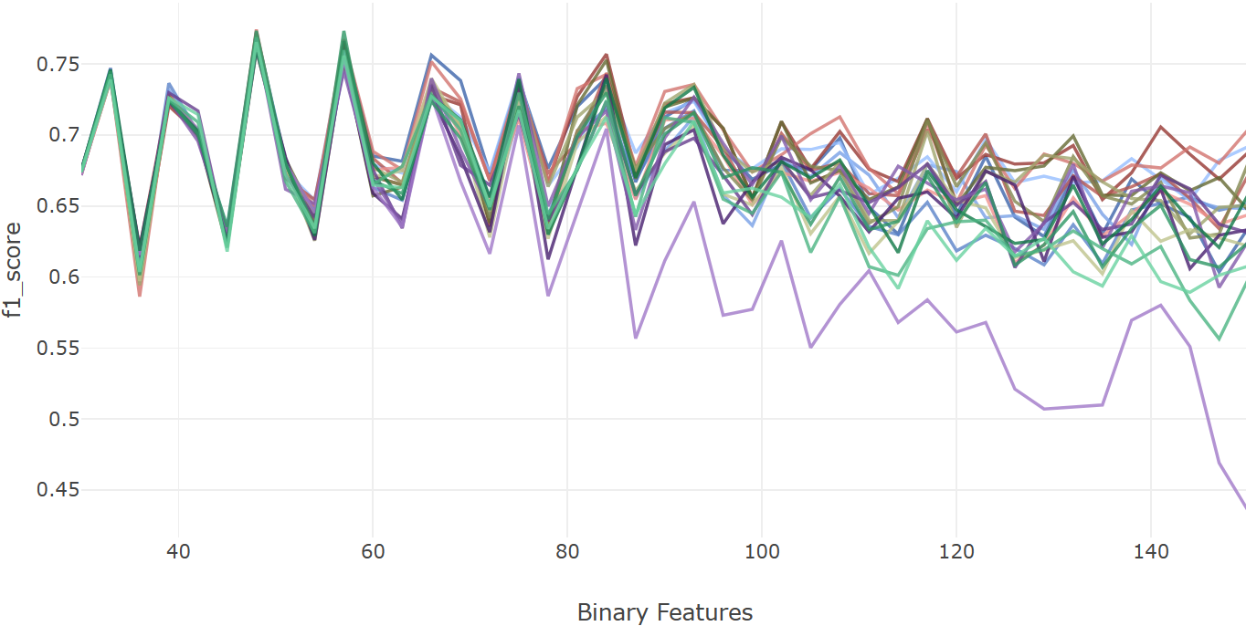
Simulated data 2 -Classification
Dataset 2
Traditional | OneHot
 | Ordinal
 | Binary
 | Target
Default | Sum
 | Purity
 | FI
 | RND
Correlation | Sum
 | Purity
 | FI
 | RND
PCA | Sum
 | Purity
 | FI
 | RND
RND | Sum
 | Purity
 | FI
 | RND
Notes:
此為連續資料集二於不同二元特徵個數下的分類成績折線

Slide 69

Simulated data 3 -Classification
Dataset 3
Traditional | OneHot
 | Ordinal
 | Binary
 | Target
Default | Sum
 | Purity
 | FI
 | RND
Correlation | Sum
 | Purity
 | FI
 | RND
PCA | Sum
 | Purity
 | FI
 | RND
RND | Sum
 | Purity
 | FI
 | RND
Notes:
此為連續資料集三於不同二元特徵個數下的分類成績折線，
觀察了先前的折線圖可見，在切分的二元變數數量較少時，所有變數編碼產生的數值資料有著相近的分類成績；
然而，隨著所切分的二元變數個數增加，變數編碼產生數值資料的分類成績之間的變異也逐漸增加、
且分類成績也有著緩步下降的趨勢，類似在維度災難發生時導致的模型成果下降。

Slide 70


Methodology - BCD encode
However, mostly the original binary data is sparse, not every 8421BCD scenario will appear. And if there are $k$ features in one group, the range of BCD encoded data will within $\left\{F_{j}^{n}∈ℝ | 0≤F_{j}^{n}<2^{k}−1\right\}$.
This cause the encoded data expand in range when $k$ is large, making both Euclidean distance calculation complicated and the sparsity between samples. A simple way to solve it is replace the BCD code with its ranking within the new feature.
Sorted
BCD
Ranked
Notes:
別別別

Slide 71

Methodology - BCD encode
Sorted
BCD
Ranked

Slide 72

Simulated data - seq. by sum
Sequence by column sum | BCD
Notes:
These is a demonstration of PCA grouping before sequenced by column sum.
in each PC we can see columns from different axis, and also, compare PC1 to PC5, PC5 only has small size binary features. Meaning binary features in PC1 has more samples can explain more variance to the whole data.
The BCD result is reasonable too, the informative seems dwindling by PCs.

Slide 73


Simulated data - group by PCA
Binarize Data | Grouped by PCA

Slide 74

Continuous data - group by Corr.
Original Group | Grouped by Correlation

Slide 75

Simulated data - seq. by impurity
Sequence by impurity | BCD encoded

Slide 76


Simulated data - seq. comparison
 | Sequenced | BCD
Randomly
By Impurity

Slide 77
Animal |  |  |  |  |  |  |  | Size |  |  |  | Color
Tuna | Cat | Frog | Cod | Goat | Dog | Toad | Cow | Large | Mid | Small | Tiny | White | Black | Red | Blue | Green | Gray
0 | 0 | 0 | 0 | 0 | 0 | 0 | 1 | 1 | 0 | 0 | 0 | 1 | 0 | 0 | 0 | 0 | 0
1 | 0 | 0 | 0 | 0 | 0 | 0 | 0 | 0 | 1 | 0 | 0 | 0 | 1 | 0 | 0 | 0 | 0
⁝ | ⁝ | ⁝ | ⁝ | ⁝ | ⁝ | ⁝ | ⁝ | ⁝ | ⁝ | ⁝ | ⁝ | ⁝ | ⁝ | ⁝ | ⁝ | ⁝ | ⁝
0 | 0 | 1 | 0 | 0 | 0 | 0 | 1 | 0 | 0 | 0 | 1 | 0 | 0 | 0 | 0 | 1 | 0
No. | PC 1 |  |  | PC 2 |  |  | PC 3
 | Feature | Abs. weight | select | Feature | Abs. weight | select | Feature | Abs. weight | select
1. | Cow | 0.562 | O | Cat | 0.642 | X | Black | 0.047 | X
2. | Cat | 0.486 | O | Cow | 0.496 | X | Goat | 0.035 | X
3. | Large | 0.348 | O | Mid | 0.402 | X | Cat | 0.032 | X
4. | Mid | 0.311 | O | Black | 0.351 | X | Cow | 0.030 | X
5. | White | 0.307 | O | Goat | 0.302 | O | Mid | 0.028 | X
6. | Black | 0.202 | O | Dog | 0.229 | O | Gray | 0.023 | X
7. | Small | 0.187 | X | Large | 0.199 | X | White | 0.021 | X
8. | Goat | 0.153 | X | Frog | 0.183 | O | Dog | 0.020 | X
9. | Cod | 0.101 | X | Small | 0.152 | O | Large | 0.018 | X
10. | Tuna | 0.091 | X | Gray | 0.132 | O | Frog | 0.016 | X
11. | Dog | 0.074 | X | White | 0.105 | X | Small | 0.014 | X
12. | Gray | 0.060 | X | Red | 0.008 | O | Toad | 0.014 | O
13. | Frog | 0.056 | X | Frog | 0.008 | X | Tuna | 0.012 | O
14. | Toad | 0.032 | X | Red | 0.007 | X | Cod | 0.007 | O
15. | Red | 0.029 | X | Toad | 0.005 | X | Red | 0.005 | X
16. | Tiny | 0.023 | X | Green | 0.001 | X | Tiny | 0.002 | O
17. | Green | 0.015 | X | Tiny | 0.001 | X | Blue | 0.001 | O
18. | Blue | 0.009 | X | Blue | 0.001 | X | Green | 0.001 | O
PC 1 |  |  |  |  |  | PC 2 |  |  |  |  |  | PC 3
Cow | Cat | Large | Mid | White | Black | Goat | Dog | Frog | Small | Gray | Red | Toad | Tuna | Cod | Tiny | Blue | Green
1 | 0 | 1 | 0 | 1 | 0 | 0 | 0 | 0 | 0 | 0 | 0 | 0 | 0 | 0 | 0 | 0 | 0
0 | 0 | 0 | 1 | 0 | 1 | 0 | 0 | 0 | 0 | 0 | 0 | 0 | 1 | 0 | 0 | 0 | 0
⁝ | ⁝ | ⁝ | ⁝ | ⁝ | ⁝ | ⁝ | ⁝ | ⁝ | ⁝ | ⁝ | ⁝ | ⁝ | ⁝ | ⁝ | ⁝ | ⁝ | ⁝
1 | 0 | 0 | 0 | 0 | 0 | 0 | 0 | 1 | 0 | 0 | 0 | 0 | 0 | 0 | 1 | 0 | 1
Tuna | Cat | Frog | Cod | Goat | Dog | Toad | Cow | Large | Mid | Small | Tiny | White | Black | Red | Blue | Green | Gray
0 | 0 | 0 | 0 | 0 | 0 | 0 | 1 | 1 | 0 | 0 | 0 | 1 | 0 | 0 | 0 | 0 | 0
1 | 0 | 0 | 0 | 0 | 0 | 0 | 0 | 0 | 1 | 0 | 0 | 0 | 1 | 0 | 0 | 0 | 0
⁝ | ⁝ | ⁝ | ⁝ | ⁝ | ⁝ | ⁝ | ⁝ | ⁝ | ⁝ | ⁝ | ⁝ | ⁝ | ⁝ | ⁝ | ⁝ | ⁝ | ⁝
0 | 0 | 1 | 0 | 0 | 0 | 0 | 1 | 0 | 0 | 0 | 1 | 0 | 0 | 0 | 0 | 1 | 0

Slide 78
Corr 1 |  |  |  |  |  | Corr 2 |  |  |  |  |  | Corr 3
Cow | Cat | Large | Mid | White | Black | Goat | Dog | Frog | Small | Gray | Red | Toad | Tuna | Cod | Tiny | Blue | Green
1 | 0 | 1 | 0 | 1 | 0 | 0 | 0 | 0 | 0 | 0 | 0 | 0 | 0 | 0 | 0 | 0 | 0
0 | 0 | 0 | 1 | 0 | 1 | 0 | 0 | 0 | 0 | 0 | 0 | 0 | 1 | 0 | 0 | 0 | 0
⁝ | ⁝ | ⁝ | ⁝ | ⁝ | ⁝ | ⁝ | ⁝ | ⁝ | ⁝ | ⁝ | ⁝ | ⁝ | ⁝ | ⁝ | ⁝ | ⁝ | ⁝
1 | 0 | 0 | 0 | 0 | 0 | 0 | 0 | 1 | 0 | 0 | 0 | 0 | 0 | 0 | 1 | 0 | 1
 | Tuna | Cat | Frog | Cod | Goat | Dog | Toad | Cow | Large | Mid | Small | Tiny | White | Black | Red | Blue | Green | Gray
Tuna | 1.0 | 0.2 | 0.2 | 0.8 | 0.2 | 0.2 | 0.8 | 0.2 | 0.1 | 0.1 | 0.1 | 0.3 | 0.0 | 0.0 | 0.0 | 0.5 | 0.5 | 0.0
Cat | 0.2 | 1.0 | 0.2 | 0.2 | 0.2 | 0.2 | 0.2 | 0.8 | 0.3 | 0.3 | 0.1 | 0.1 | 0.2 | 0.2 | 0.0 | 0.0 | 0.0 | 0.0
Frog | 0.2 | 0.2 | 1.0 | 0.2 | 0.8 | 0.8 | 0.2 | 0.2 | 0.1 | 0.1 | 0.3 | 0.1 | 0.0 | 0.0 | 0.3 | 0.0 | 0.0 | 0.3
Cod | 0.8 | 0.2 | 0.2 | 1.0 | 0.2 | 0.2 | 0.8 | 0.8 | 0.1 | 0.1 | 0.1 | 0.3 | 0.0 | 0.0 | 0.0 | 0.3 | 0.3 | 0.0
Goat | 0.2 | 0.2 | 0.8 | 0.2 | 1.0 | 0.8 | 0.2 | 0.2 | 0.1 | 0.1 | 0.3 | 0.1 | 0.0 | 0.0 | 0.3 | 0.0 | 0.0 | 0.3
Dog | 0.2 | 0.2 | 0.8 | 0.2 | 0.8 | 1.0 | 0.2 | 0.2 | 0.1 | 0.1 | 0.3 | 0.1 | 0.0 | 0.0 | 0.3 | 0.0 | 0.0 | 0.3
Toad | 0.8 | 0.2 | 0.2 | 0.8 | 0.2 | 0.2 | 1.0 | 0.2 | 0.1 | 0.1 | 0.1 | 0.3 | 0.0 | 0.0 | 0.0 | 0.3 | 0.0 | 0.0
Cow | 0.2 | 0.8 | 0.2 | 0.8 | 0.2 | 0.2 | 0.2 | 1.0 | 0.3 | 0.3 | 0.1 | 0.1 | 0.3 | 0.3 | 0.0 | 0.0 | 0.0 | 0.0
Large | 0.1 | 0.3 | 0.1 | 0.1 | 0.1 | 0.1 | 0.1 | 0.3 | 1.0 | 0.5 | 0.1 | 0.1 | 0.6 | 0.6 | 0.2 | 0.2 | 0.2 | 0.2
Mid | 0.1 | 0.3 | 0.1 | 0.1 | 0.1 | 0.1 | 0.1 | 0.3 | 0.5 | 1.0 | 0.1 | 0.1 | 0.6 | 0.6 | 0.2 | 0.2 | 0.2 | 0.2
Small | 0.1 | 0.1 | 0.3 | 0.1 | 0.3 | 0.3 | 0.1 | 0.1 | 0.1 | 0.1 | 1.0 | 0.1 | 0.2 | 0.2 | 0.6 | 0.2 | 0.2 | 0.6
Tiny | 0.3 | 0.1 | 0.1 | 0.3 | 0.1 | 0.1 | 0.3 | 0.1 | 0.1 | 0.1 | 0.1 | 1.0 | 0.2 | 0.2 | 0.2 | 0.6 | 0.2 | 0.2
White | 0.0 | 0.2 | 0.0 | 0.0 | 0.0 | 0.0 | 0.0 | 0.3 | 0.6 | 0.6 | 0.2 | 0.2 | 1.0 | 0.8 | 0.4 | 0.4 | 0.4 | 0.4
Black | 0.0 | 0.2 | 0.0 | 0.0 | 0.0 | 0.0 | 0.0 | 0.3 | 0.6 | 0.6 | 0.2 | 0.2 | 0.8 | 1.0 | 0.4 | 0.4 | 0.4 | 0.8
Red | 0.0 | 0.0 | 0.3 | 0.0 | 0.3 | 0.3 | 0.0 | 0.0 | 0.2 | 0.2 | 0.6 | 0.2 | 0.4 | 0.4 | 1.0 | 0.4 | 0.4 | 0.4
Blue | 0.5 | 0.0 | 0.0 | 0.3 | 0.0 | 0.0 | 0.3 | 0.0 | 0.2 | 0.2 | 0.2 | 0.6 | 0.4 | 0.4 | 0.4 | 1.0 | 0.8 | 0.8
Green | 0.5 | 0.0 | 0.0 | 0.3 | 0.0 | 0.0 | 0.0 | 0.0 | 0.2 | 0.2 | 0.2 | 0.2 | 0.4 | 0.4 | 0.4 | 0.8 | 1.0 | 0.4
Gray | 0.0 | 0.0 | 0.3 | 0.0 | 0.3 | 0.3 | 0.0 | 0.0 | 0.2 | 0.2 | 0.6 | 0.2 | 0.4 | 0.8 | 0.4 | 0.8 | 0.4 | 1.0
 | Cow | Cat | Large | Mid | White | Black | Goat | Dog | Frog | Small | Gray | Red | Toad | Tuna | Cod | Tiny | Blue | Green
Cow | 1.0 | 0.8 | 0.3 | 0.3 | 0.5 | 0.5 | 0.2 | 0.2 | 0.2 | 0.1 | 0.0 | 0.0 | 0.2 | 0.2 | 0.2 | 0.1 | 0.0 | 0.0
Cat | 0.8 | 1.0 | 0.3 | 0.3 | 0.5 | 0.5 | 0.2 | 0.2 | 0.2 | 0.1 | 0.0 | 0.0 | 0.2 | 0.2 | 0.2 | 0.1 | 0.0 | 0.0
Large | 0.3 | 0.3 | 1.0 | 0.5 | 0.6 | 0.6 | 0.1 | 0.1 | 0.1 | 0.1 | 0.2 | 0.2 | 0.1 | 0.1 | 0.1 | 0.1 | 0.2 | 0.2
Mid | 0.3 | 0.3 | 0.5 | 1.0 | 0.6 | 0.6 | 0.1 | 0.1 | 0.1 | 0.1 | 0.2 | 0.2 | 0.1 | 0.1 | 0.1 | 0.1 | 0.2 | 0.2
White | 0.5 | 0.5 | 0.6 | 0.6 | 1.0 | 0.8 | 0.0 | 0.0 | 0.0 | 0.2 | 0.4 | 0.4 | 0.0 | 0.0 | 0.0 | 0.2 | 0.4 | 0.4
Black | 0.5 | 0.5 | 0.6 | 0.6 | 0.8 | 1.0 | 0.0 | 0.0 | 0.0 | 0.2 | 0.4 | 0.4 | 0.0 | 0.0 | 0.0 | 0.2 | 0.4 | 0.4
Goat | 0.2 | 0.2 | 0.1 | 0.1 | 0.0 | 0.0 | 1.0 | 0.8 | 0.8 | 0.3 | 0.3 | 0.3 | 0.2 | 0.2 | 0.2 | 0.1 | 0.0 | 0.0
Dog | 0.2 | 0.2 | 0.1 | 0.1 | 0.0 | 0.0 | 0.8 | 1.0 | 0.8 | 0.3 | 0.5 | 0.5 | 0.2 | 0.2 | 0.2 | 0.1 | 0.0 | 0.0
Frog | 0.2 | 0.2 | 0.1 | 0.1 | 0.0 | 0.0 | 0.8 | 0.8 | 1.0 | 0.3 | 0.5 | 0.5 | 0.2 | 0.2 | 0.2 | 0.1 | 0.0 | 0.0
Small | 0.1 | 0.1 | 0.1 | 0.1 | 0.2 | 0.2 | 0.3 | 0.3 | 0.3 | 1.0 | 0.6 | 0.6 | 0.1 | 0.1 | 0.1 | 0.1 | 0.2 | 0.2
Gray | 0.0 | 0.0 | 0.2 | 0.2 | 0.4 | 0.4 | 0.3 | 0.5 | 0.5 | 0.6 | 1.0 | 0.8 | 0.0 | 0.0 | 0.0 | 0.2 | 0.4 | 0.4
Red | 0.0 | 0.0 | 0.2 | 0.2 | 0.4 | 0.4 | 0.3 | 0.5 | 0.5 | 0.6 | 0.8 | 1.0 | 0.0 | 0.0 | 0.0 | 0.2 | 0.4 | 0.4
Toad | 0.2 | 0.2 | 0.1 | 0.1 | 0.0 | 0.0 | 0.2 | 0.2 | 0.2 | 0.1 | 0.0 | 0.0 | 1.0 | 0.8 | 0.8 | 0.3 | 0.5 | 0.5
Tuna | 0.2 | 0.2 | 0.1 | 0.1 | 0.0 | 0.0 | 0.2 | 0.2 | 0.2 | 0.1 | 0.0 | 0.0 | 0.8 | 1.0 | 0.8 | 0.3 | 0.5 | 0.5
Cod | 0.2 | 0.2 | 0.1 | 0.1 | 0.0 | 0.0 | 0.2 | 0.2 | 0.2 | 0.1 | 0.0 | 0.0 | 0.8 | 0.8 | 1.0 | 0.3 | 0.5 | 0.5
Tiny | 0.1 | 0.1 | 0.1 | 0.1 | 0.2 | 0.2 | 0.1 | 0.1 | 0.1 | 0.1 | 0.2 | 0.2 | 0.3 | 0.3 | 0.3 | 1.0 | 0.6 | 0.6
Blue | 0.0 | 0.0 | 0.2 | 0.2 | 0.4 | 0.4 | 0.0 | 0.0 | 0.0 | 0.2 | 0.4 | 0.4 | 0.5 | 0.5 | 0.5 | 0.6 | 1.0 | 0.8
Green | 0.0 | 0.0 | 0.2 | 0.2 | 0.4 | 0.4 | 0.0 | 0.0 | 0.0 | 0.2 | 0.4 | 0.4 | 0.5 | 0.5 | 0.5 | 0.6 | 0.8 | 1.0

Slide 82


Slide 83
 | Sequenced Column Group |  |  |  |  |  | BCD | Type
 | Blue | Tuna | Tiny | Toad | Green | Cod
Sample 1 | 1 | 0 | 0 | 0 | 0 | 1 | 33 | Good
Sample 2 | 1 | 0 | 0 | 1 | 0 | 0 | 36 | Good
Sample 3 | 0 | 0 | 1 | 0 | 1 | 0 | 10 | Bad
Sample 4 | 0 | 0 | 1 | 1 | 1 | 0 | 14 | Bad
⁝ | ⁝ | ⁝ | ⁝ | ⁝ | ⁝ | ⁝ | ⁝ | ⁝

Slide 84



Instances | X | Y | Z
1 | x.2 | y.9 | z.4
2 | x.1 | y.8 | z.2
3 | x.9 | y.1 | z.6
4 | x.5 | y.7 | z.8
5 | x.3 | y.1 | z.8
6 | x.5 | y.6 | z.3
7 | x.7 | y.5 | z.4
⁝ | ⁝ | ⁝ | ⁝
3300 | x.4 | y.8 | z.1
Instances | x.1 | x.2 | x.3 | x.4 | x.5 | x.6 | … | z.9 | z.10
1 | 0 | 1 | 0 | 0 | 0 | 0 | … | 0 | 0
2 | 1 | 0 | 0 | 0 | 0 | 0 | … | 0 | 0
3 | 0 | 0 | 0 | 0 | 0 | 0 | … | 0 | 0
4 | 0 | 0 | 0 | 0 | 1 | 0 | … | 0 | 0
5 | 0 | 0 | 1 | 0 | 0 | 0 | … | 0 | 0
6 | 0 | 0 | 0 | 0 | 1 | 0 | … | 0 | 0
7 | 0 | 0 | 0 | 0 | 0 | 0 | … | 0 | 0
⁝ | ⁝ | ⁝ | ⁝ | ⁝ | ⁝ | ⁝ | ⁝ | ⁝ | ⁝
3300 | 0 | 0 | 0 | 1 | 0 | 0 | … | 0 | 0

Slide 85



Traditional | OneHot
 | Ordinal
 | Binary
 | Target
Default | Sum
 | Purity
 | FI
 | RND
Correlation | Sum
 | Purity
 | FI
 | RND
PCA | Sum
 | Purity
 | FI
 | RND
RND | Sum
 | Purity
 | FI
 | RND
 | One Hot | Binary | Ordinal | Target | Purity | Purity
 | Traditional |  |  |  | Default | PCA
 | 83 | 38 | 17 |  |  | 10 | 20 | 30
 | One Hot | Binary | Ordinal | Target | Sum | Purity | FI | RND | Sum | Purity | FI | RND | Sum | Purity | FI | RND | Sum | Purity | FI | RND
 | Traditional |  |  |  | Default |  |  |  | Correlation |  |  |  | PCA |  |  |  | RND
 | 21 | 15 | 6

Slide 86




Slide 87



By purity |  | Randomly
1 | Cluster | 24

Slide 88



Difference 3D Dimension Reduced Data After Encode With Certain Sequencing
Impurity | Randomly | Sum

Slide 89

 | Purity | Purity | Purity | Purity | Purity
 | PCA
 | 10 | 20 | 30 | 40 | 50
 | Purity | Purity | Purity | Purity | Purity
 | Corr
 | 10 | 20 | 30 | 40 | 50

Slide 90



